Slide 1
Simplicity, Affordability, and Accessibility for Cybersecurity
Notes:
What is CYRISMA?
CYRISMA is a SaaS based cybersecurity risk management platform ecosystem that is Affordable, Accessible, and Easy to use enabling organizations to identify and immediately reduce their Cyber Risk.

Slide 2
Ask yourself these six questions. Can you answer them?
Do we know if the systems housing our data have vulnerabilities?
Do we know if our systems housing our data are secure?
Can we track and monitor mitigation efforts?
Do we know what type of data we have?
Do we know where our data is located?
Do we know who has access to our data?
This Photo by Unknown Author is licensed under CC BY
Notes:
As a business – Can you answer these 6 questions? If You can, you are the right path to Risk Reduction

Slide 3
Organizations suffer from the following thoughts surrounding Cyber Security:
It’s Too Complex
Tedious Ramp-Up
High Price Tag
Limited Resources
“It it’s not broke, don’t fix it”
Notes:
Typical Security Solutions
Single point products
Multiple products – Tool Fatigue, Alert Fatigue, 500-page Reports
No single view of the truth
Time consuming static reports with No Call To Action

Slide 4
The Status Quo:
Minimal ROI
Additional cost for add-on features/solutions
Most organizations only utilize 10% of the expensive offerings
Multiple interfaces to piece mail together
Notes:
Decision Process – Reasons why no action taken

Slide 5
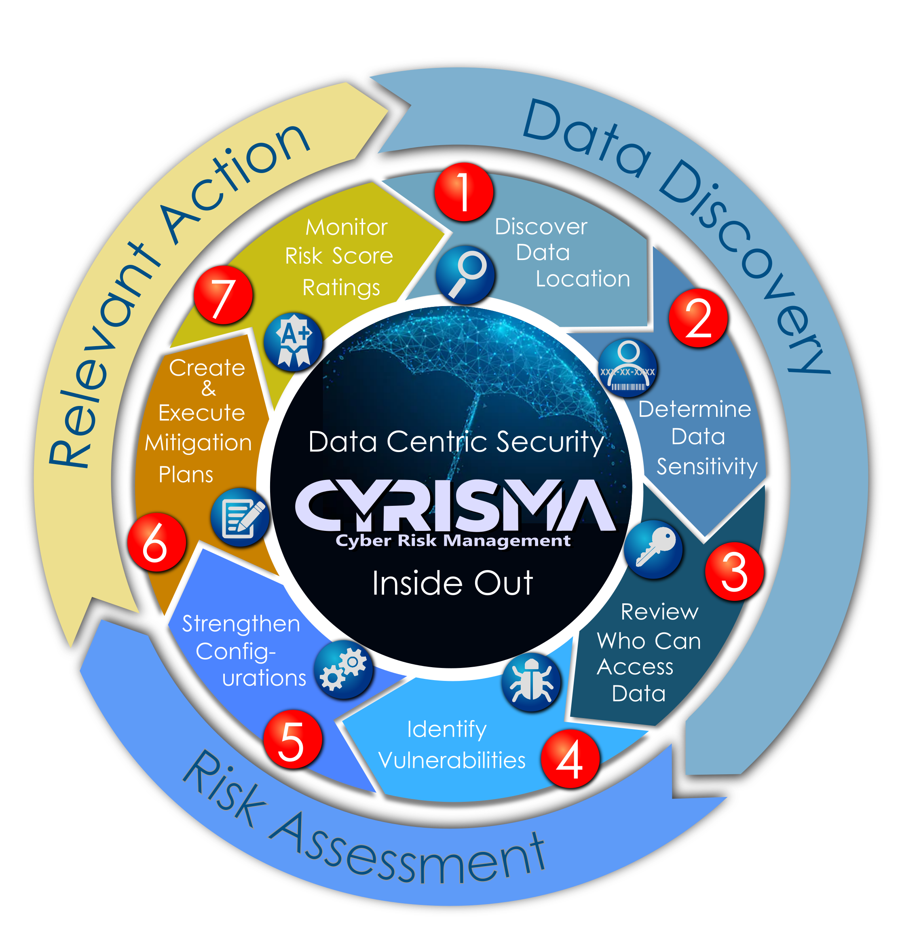
Achieve Continuous Improvement & Compliance
CYRISMA a single Interface solution organizes its features into a logical process:
Data Sensitivity
Vulnerability Management
Secure System Configuration Management
Risk Reduction through Mitigation Planning
Security Score rating with Trends and metrics
Notes:
CYRISMA focuses on the Data first and then follow our process. We have created a repeatable and unique ecosystem. CYRISMA’s distinctive methodology is based on these 3 core functions:
Data Discovery
Risk Assessment
Relevant Action
7 steps or capabilities all within the same interface.
1 Discover Data
2 Data Sensitivity
3 Who can access the data
4 Identify Vulnerabilities
5 Strengthen System Configurations
6 Create and execute mitigation plans – This allows you to track progress of the team.
7 Monitor risk scores

Slide 6
CYRISMA Capabilities
Scan for Sensitive Data such as SS#, DL#, Credit Cards, etc.
Scan different locations File Shares, Email, Database, Cloud.
Capture who has access to the sensitive Data.
Ability to Scan for Vulnerabilities and Define Root Cause Analysis.
Ability to Scan for Secure System Configurations Example CIS Benchmarks.
Create Mitigation and Track progress.
Notes:
The CYRISMA Cyber Risk Management Platform simply stated…

Slide 7
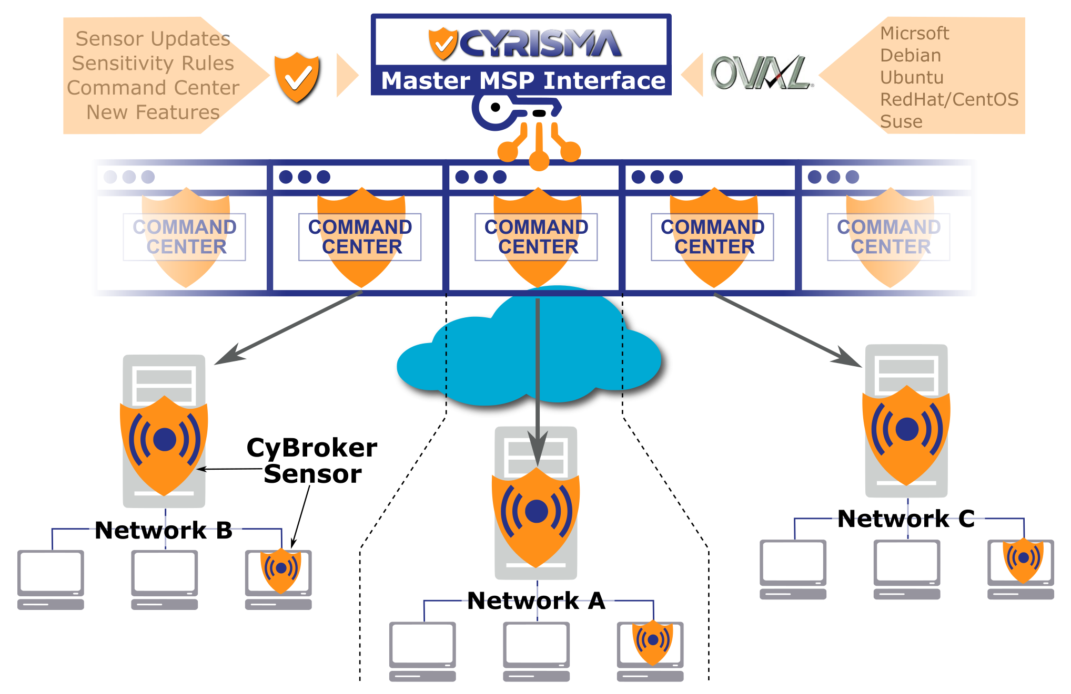
Notes:
As your trusted Cyber Risk Advisor our objective is to reduce your overall risk exposure and ensure compliance using the CYRISMA Platform Command Center managing multiple customers like you.
Search for Sensitive Data and reduce footprint before the bad actor attacks and holds it for ransom
Perform Vulnerability scanning and identify to mitigate
Scan assets against CIS benchmarks to establish tighter security controls. Reduce the risk of being breached or compromised adhering to regulatory compliance

Slide 8
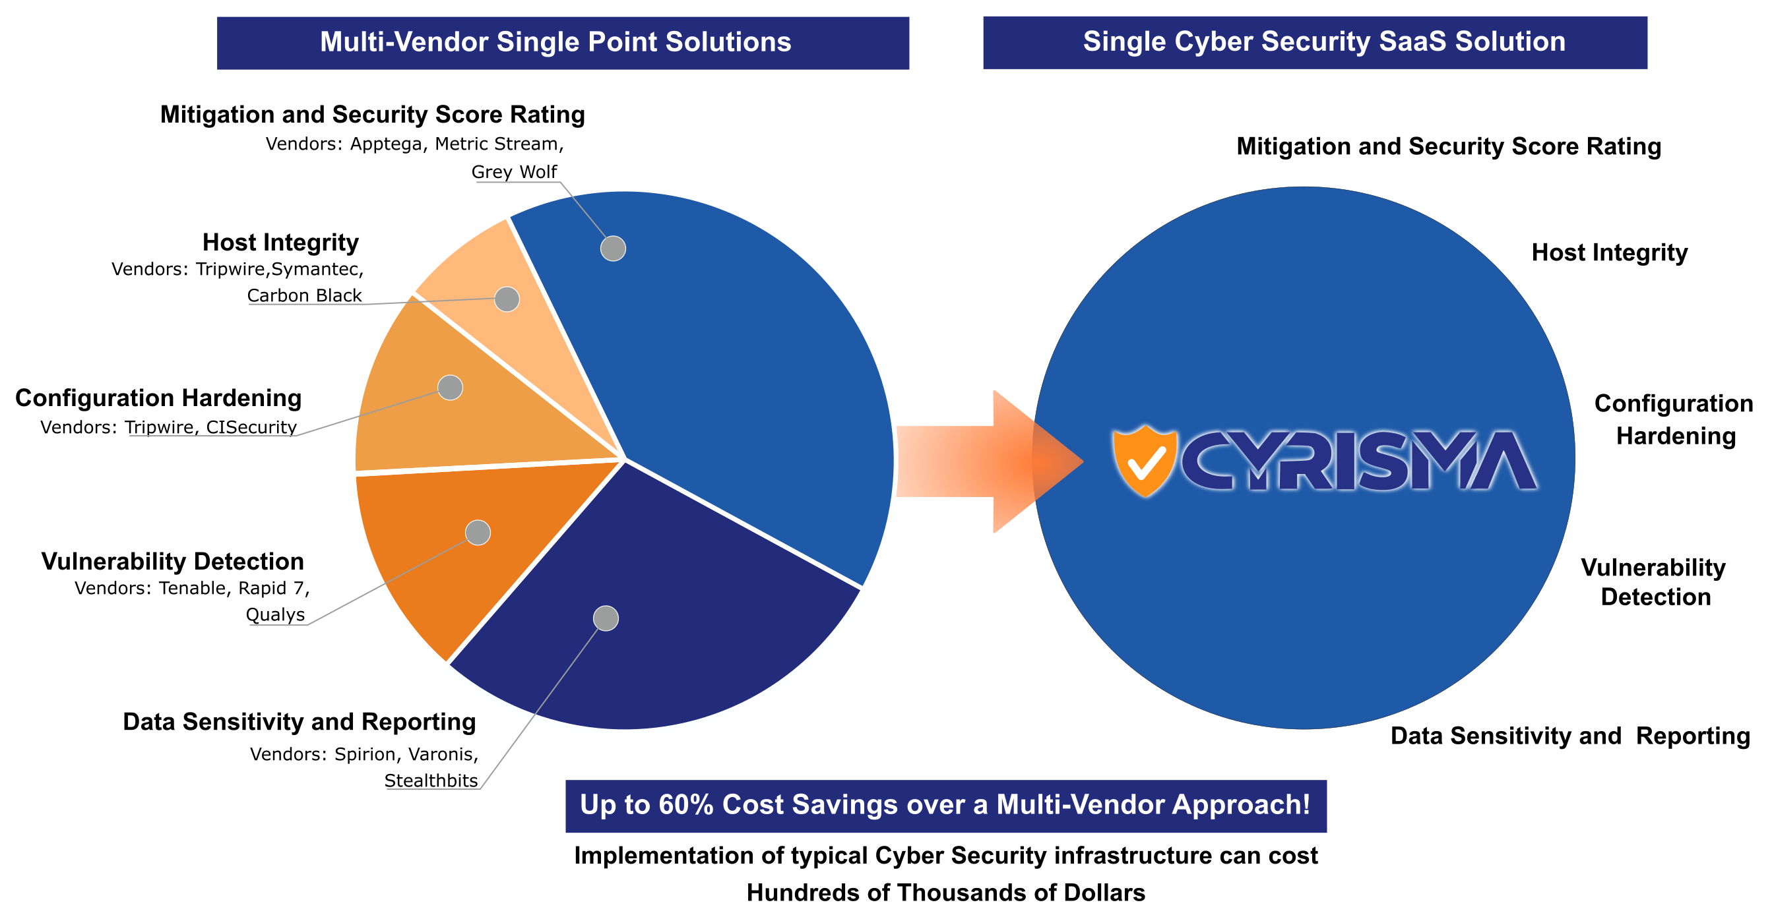
Competitive Landscape
Notes:
Reasons why to select CYRISMA Platform & Ecosystem with a Single Cyber Security SaaS Solution at a much lower cost over the multi vendor approach

