Slide 1
A guide on how to talk to your customers about risk management, rolling out a go-to-market strategy, and selling deeper into your stack.
MSP Playbook
June 2024

Slide 2
WHAT IS CYRISMA?
CYRISMA is an all-in-one cyber risk management platform that helps SMBs identify vulnerabilities, establish secure OS configurations, discover and protect sensitive data, & track compliance.
Top three features SMB customers care about
Vulnerability Scanning
Sensitive Data Discovery
Secure Configuration
Assessment

Slide 3
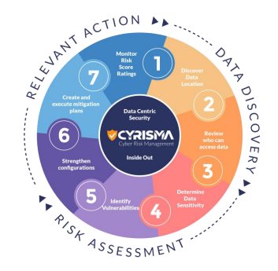
HOW CYRISMA CAN HELP YOU
CYRISMA helps MSPs manage risk successfully
DATA DISCOVERY
RISK ASSESSMENT
RELEVANT ACTION
Discover what sensitive data your customers have, where it is located and who has access to it.
Know if the systems housing the sensitive data have vulnerabilities and whether the data is secure.
Patch vulnerabilities in 3rd-party Windows-based apps. Secure sensitive data. Track mitigation.

Slide 4
COMPLIANCE
TACTICAL COMPLIANCE TRACKING
Security Frameworks Covered
CYRISMA assists in tracking controls that you can implement from within the platform.
CIS Critical Controls v8
HIPAA
Security Rule
NIST CSF
It automatically recognizes and shows you actions taken against impacted controls.
PCI DSS
SOC 2
Controls
UK Cyber Essentials
Essential Eight (Australia)

Slide 5
CUSTOMERS ASKING ABOUT AI?
AI READINESS ASSESSMENTS
Utilize our Microsoft Copilot Readiness Assessment to discuss secure GenAI deployment.
Compliance Questionnaire
Assign Questions To Team Members
Upload Supporting Documents / Evidence
Assessment Includes M365 Sensitive Data Scan Results
Customize Conclusion & Next Steps
Strategic assessments for more major compliance frameworks coming in 2024!

Slide 6
HOW TO LEVERAGE CYRISMA AS A SALES TOOL
Whether it's during an initial discovery meeting or a QBR, here’s how you can leverage our platform.
External Scans for prospecting
Ability to run External IP & Web Application scans
Agent-less External Scans – Simply get permission & information from your prospect to run the scans
Leverage POC instances
Create a temporary instance for up to 30 days before being charged
Leverage POCs and new instances at the beginning of the month for maximum benefit

Slide 7
HOW TO SELL: FREE SCAN METHOD
For initial discovery conversations, offer a free scan to identify gaps in security for the customer.
Leverage 30-day consultation instance to perform scans
​
Present the report to your customer or prospect.​
Lead to a Professional Service engagement or Managed Service Agreement
Pro Tip: Always lead the Professional Service engagement to a Managed Service Agreement or Security Stack conversation. Include the remediation as part of your Security Stack (see next slide to learn how).
​

Slide 8
HOW TO SELL: VALUE SELLING METHOD
Use CYRISMA for regular
vulnerability scans
& overall risk assessments as part of your security stack. Focus on value selling.
Continuous scans as part of a stack
Lean in on compliance
Quantify risk in monetary terms
Create success milestones for the customer
Perform regular scans; help clients identify vulnerabilities as they are published
Compliance needs often change due to breaches, or new regulatory or client requirements
Leverage risk monetization to help visualize monetary impact of potential breaches
Use risk grades to track & show progress over time. The goal is measurable improvement

Slide 9
HOW DO YOU BRING VALUE TO YOUR CUSTOMER?
Here are some ideas!
CYRISMA can give you the data, but what will YOU do with it as an MSP?
Create a security package for your client with assessments on a REGULAR basis
Use the data & risk scores to identify top PRIORITIES to fit the client budget
Collaborate with clients to identify their risk and understand their goals

Slide 10
Thank you!

