Slide 1
COMPLETE CYBER RISK MANAGEMENT
AND COMPLIANCE
Discover, Assess, Mitigate, and Manage Cyber Risk and Compliance
Notes:
Add note to this slide

Slide 2
Table of Contents
1. Cyber Risk Overview
2. Sensitive Data Discovery
3. Vulnerability Management
4. Secure Baseline Scanning
5. Compliance
6. Dark Web Monitoring
7. Risk Mitigation
Notes:
Add note to this slide

Slide 3
1
CYBER RISK OVERVIEW
Get a quick overview of your organization's current security posture based on vulnerability, data sensitivity, and security baseline scans; risk monetization data; and compliance tracking
Notes:
Add note to this slide

Slide 4
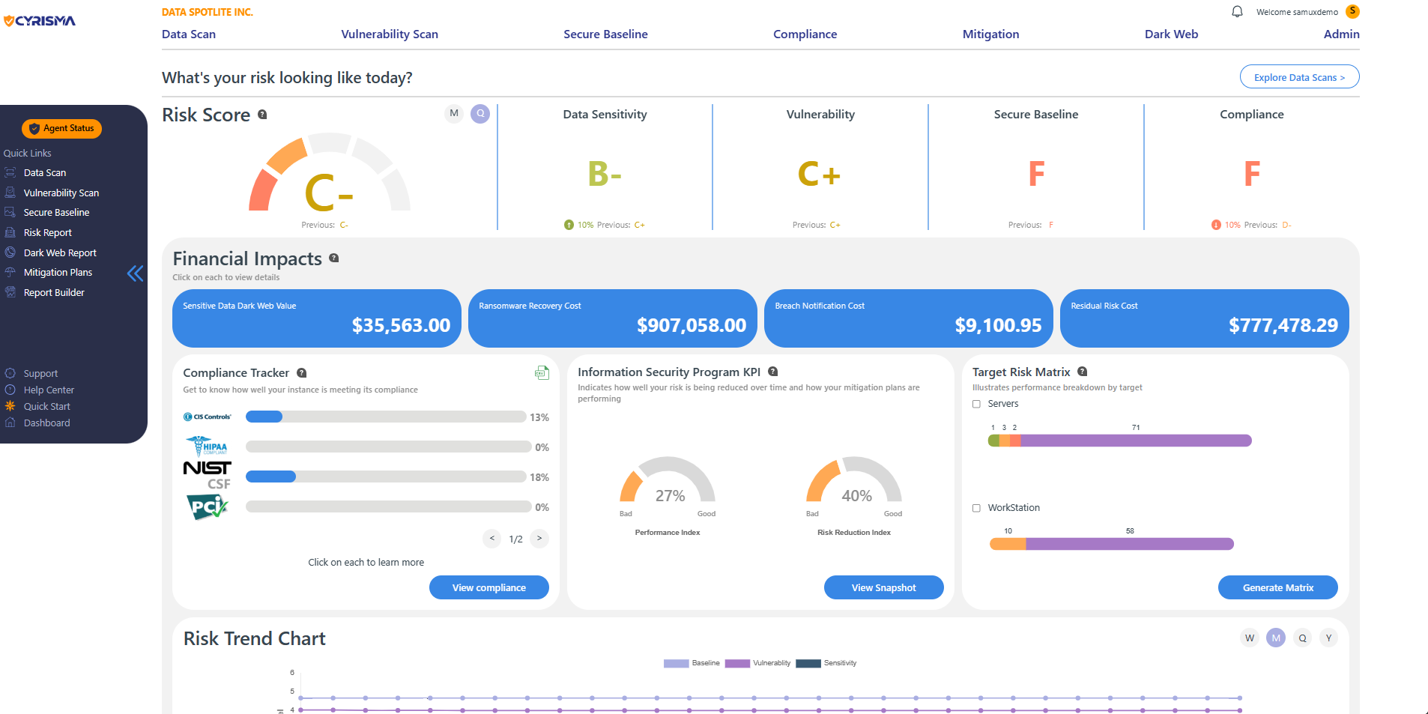
Overall Risk Dashboard
The overall risk dashboard gives you a quick overview of your organization’s current performance in different scan and assessment categories (Vulnerability, Security Baseline, Sensitive Data, Compliance); risk monetization data; compliance status; and risk mitigation efforts.
Notes:
Add note to this slide

Slide 5
Estimate of monetary losses due to potential security incidents
Sensitive Data Dark Web value
The dark web value of the sensitive data discovered in your environment. Sensitive data may include Credit Card numbers, SSNs, Passwords, PII, and more (choose from dozens of data categories)
Ransomware Recovery Cost
The cost to recover in case your organization is hit by ransomware. Includes system recovery costs based on the number of machines and employees affected, downtime costs, and sensitive data value.
Breach Notification Cost
Cost to notify persons (customers, partners & others) whose data was compromised due to a security incident. Covers investigation costs, fines, class action lawsuits corresponding with each data category.
Residual Risk Cost
The “residual” cost that remains after putting security controls in place, and how it can be lowered. Based on questions cyber insurance companies will ask and the risk associated with not having appropriate solutions.
Notes:
Add note to this slide

Slide 6
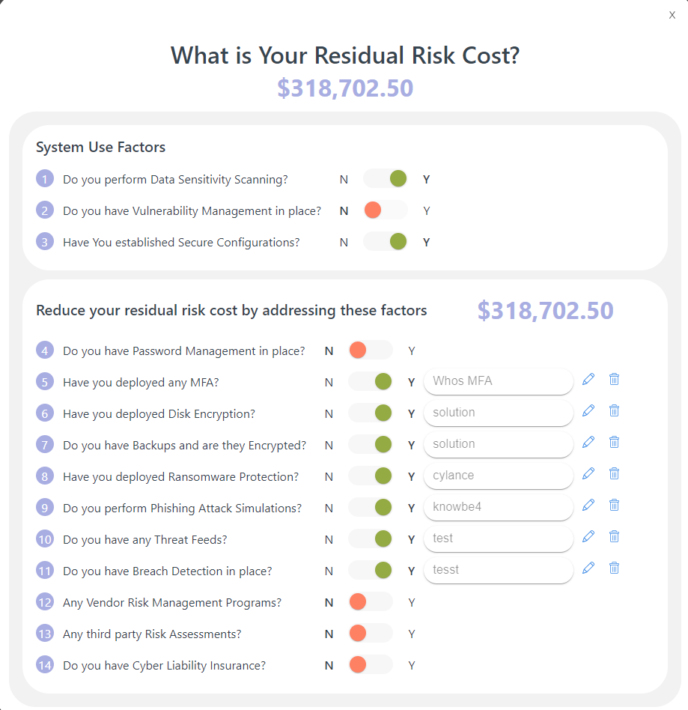
Residual Risk
Adjustment
See your Residual Risk cost go down as you implement essential security controls and check them off the Residual Risk Adjustment Questionnaire.
Notes:
Add note to this slide

Slide 7
Overall and Category-Specific Risk Grades
Overall Cyber Risk
The overall risk grade is based on a combination of vulnerability, sensitive data and secure baseline scan results on company laptops, desktops or servers.
Data Sensitivity
The Data Sensitivity grade is based on the volume and type of sensitive data found on your company’s systems. Track progress over time by comparing past and present risk grades.
Vulnerability Scanning
The Vulnerability Grade is based on Internal Authenticated & Unauthenticated, External, and Web App scans across your organization’s computing environments (on-prem & cloud)
Secure Baseline Scans
The Baseline grade is based on performance in secure configuration scans on different operating systems. Compare OS configuration settings against established security frameworks.
Compliance
The Compliance Grade is based on the aggregate performance of the organization on Compliance with various regulatory frameworks.
Notes:
Add note to this slide

Slide 8
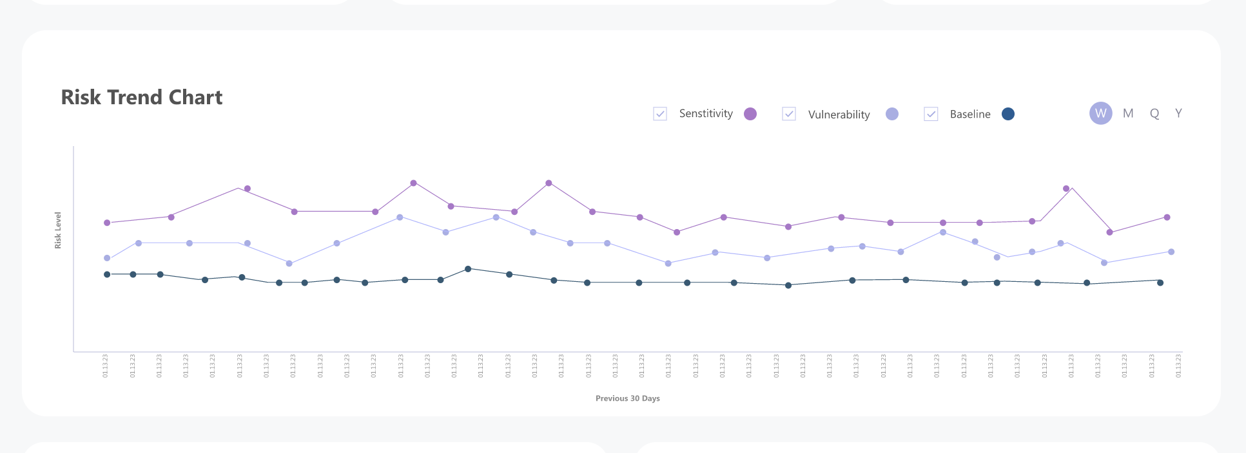
Risk Trend
View performance in each of the three scan categories - Data Sensitivity, Vulnerability Management, and Secure Baseline - over a selected period of time, based on risk levels A through F.
Notes:
Add note to this slide

Slide 9
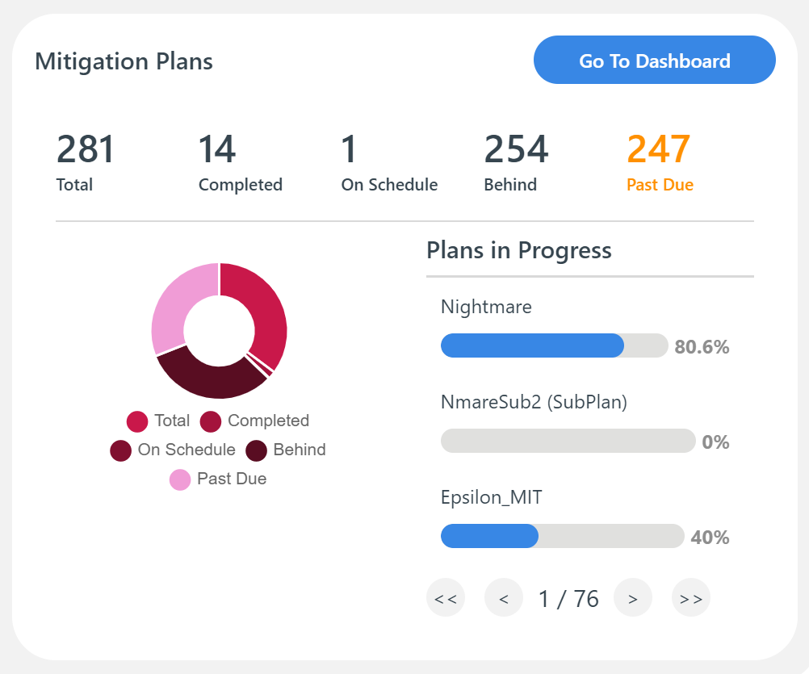
Mitigation Plan Status
Get an overview of mitigation plans in progress – all assigned mitigation plans for your organization/instance, and their status. Drill-down into latest mitigations in progress, the individuals responsible for each plan, due dates, and the percentage progress on each.
Notes:
Add note to this slide

Slide 10
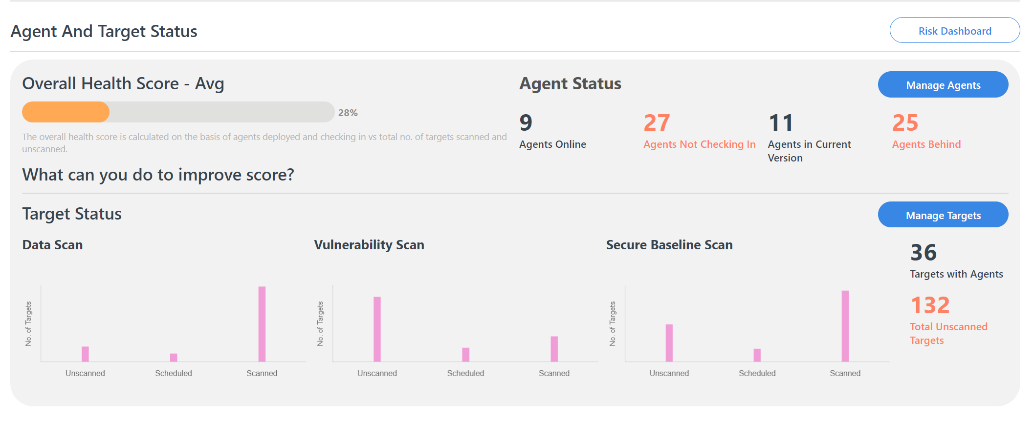
Agent Status
Easily manage your Agents and the Targets on which Agents are deployed. Get quick access to information about online and offline Agents, and the number of Targets (systems or devices) covered under each scan category.
Notes:
Add note to this slide

Slide 11
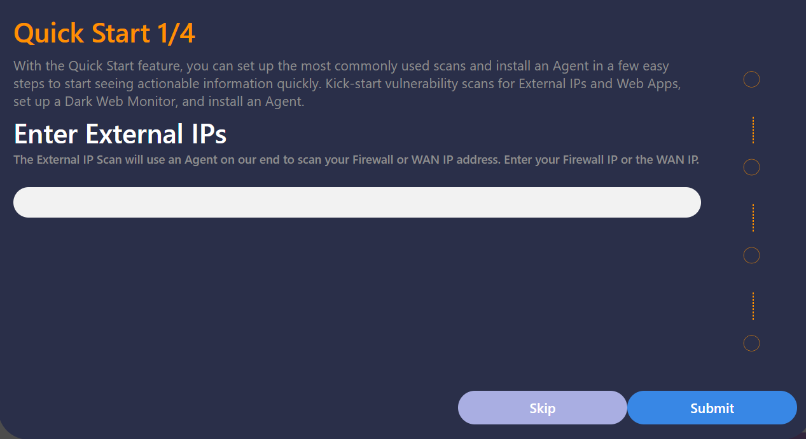
Quick Start
With the Quick Start feature, you can set up the most commonly used scans and install an Agent in a few easy steps to start seeing actionable information quickly. Kick-start vulnerability scans for External IPs and Web Apps, set up a Dark Web Monitor, and install an Agent.
Notes:
Add note to this slide

Slide 12
2
SENSITIVE DATA DISCOVERY
Discover the sensitive data in your cloud and on-prem environments. Scan company systems, email inboxes, Microsoft Office 365 (Exchange 365, SharePoint, OneDrive) and Google Cloud (Gmail messages and attachments, Google Drive, other Google Workspace apps) for any sensitive data that isn’t adequately protected.
Understand what sensitive data was found, where it was found and the associated risk for your business. Mitigate risk by taking immediate steps to secure this data.
Notes:
Add note to this slide

Slide 13
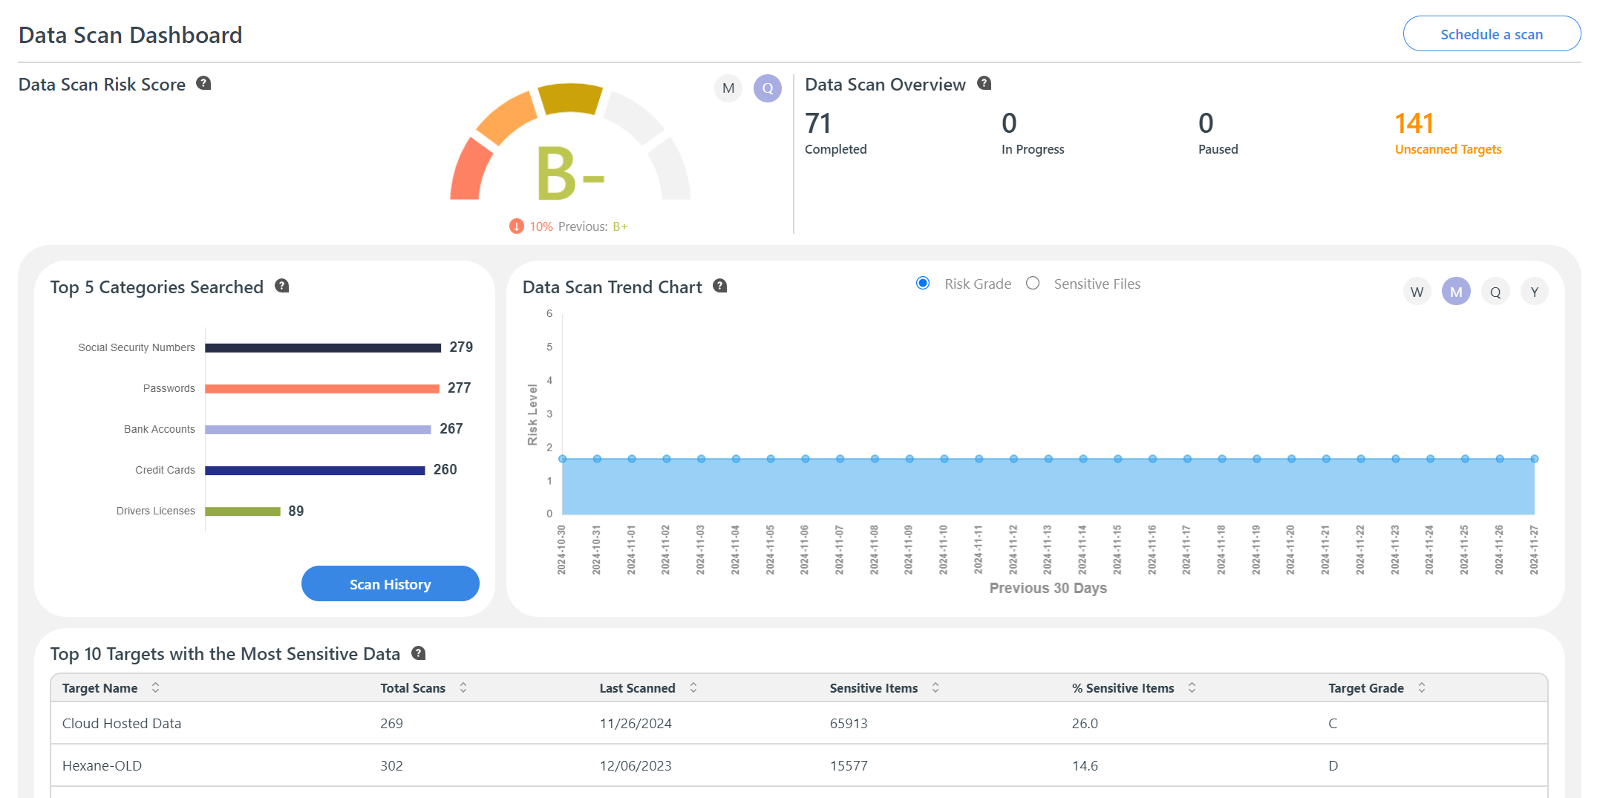
Data Scan Dashboard
Scan systems for dozens of sensitive data categories (Credit Card numbers, Social Security Numbers, Passwords, PII and much more).
View current and previous performance grades based on data scan results
Get a quick overview of the top five data categories scanned and scan trends over time.
Notes:
Add note to this slide

Slide 14
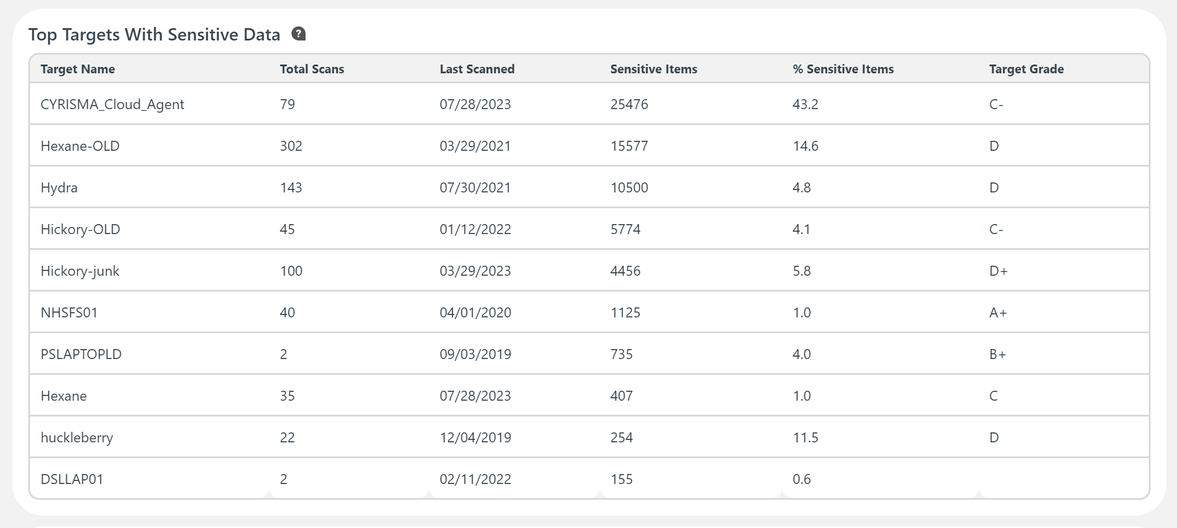
Easily prioritize data protection tasks based on
information about where your most sensitive data resides
Notes:
Add note to this slide

Slide 15
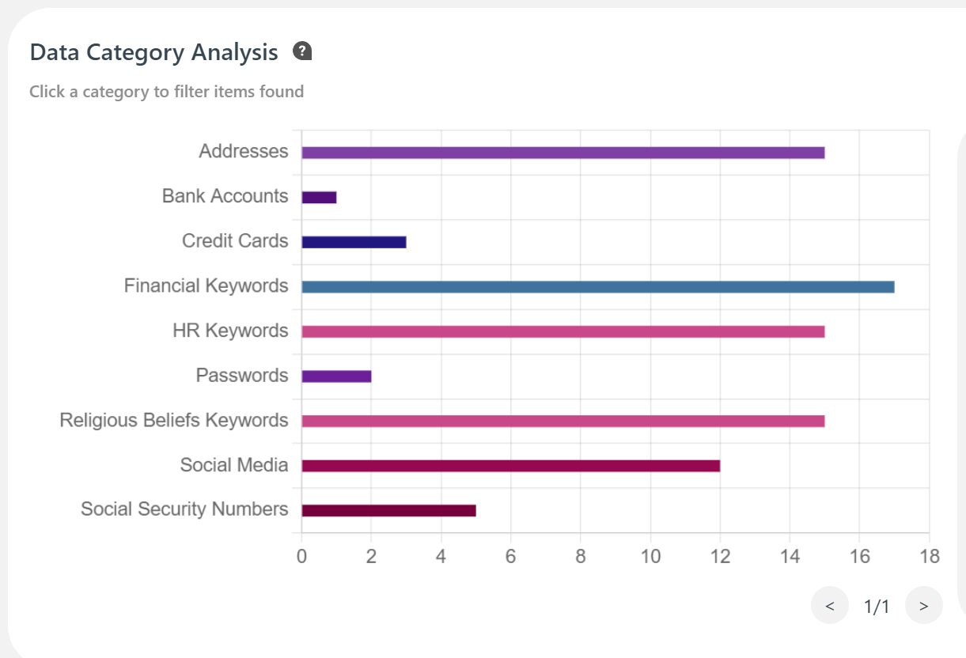
Data Category Analysis
View the the overall category breakdown of what sensitive data was discovered during scans.
See exactly which items were found for a particular category.
Notes:
Add note to this slide

Slide 16
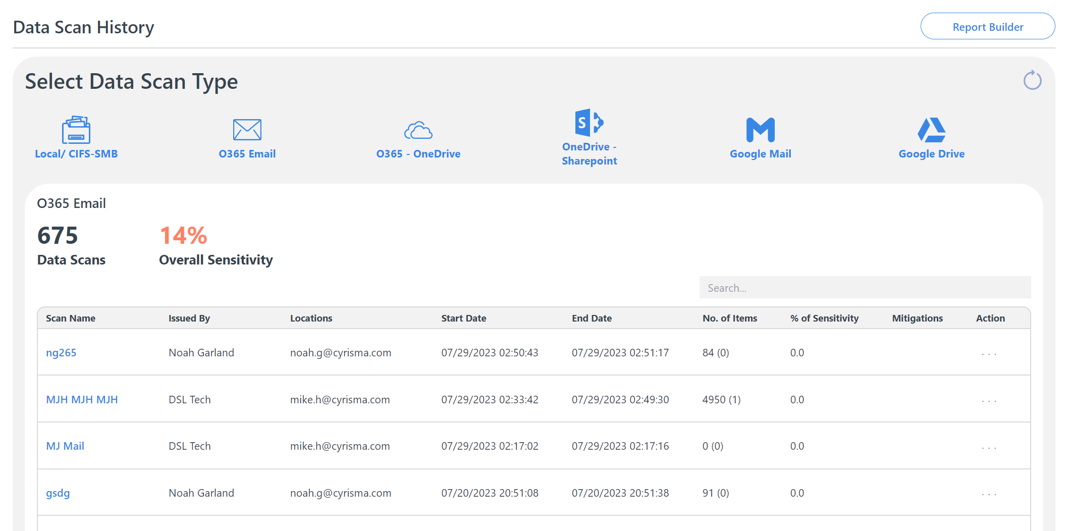
Sensitive Data
Scan History
View scan history, easily schedule and run scans, and create mitigation plans to secure the sensitive data found.
Mitigation actions include deleting, protecting data with a password, encrypting data, changing access permissions or moving it to a secure location.
Notes:
Add note to this slide

Slide 17
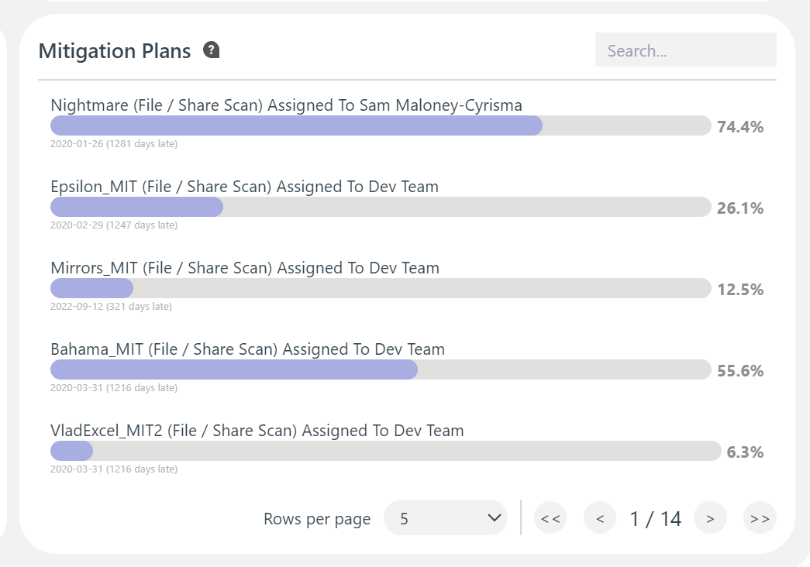
Mitigation Plans in Progress
Get a quick overview of mitigation plans in progress, with information about who the tasks are assigned to, the due dates, and progress percentage for each.
Data Scan Reports
Easily generate Sensitive Data Scan reports. View Risk Grades, Items found, Sensitive files found & their locations
Notes:
Add note to this slide

Slide 18
3
VULNERABILITY MANAGEMENT
Perform Internal (Authenticated & Unauthenticated), External, and Web App Vulnerability Scans, understand the vulnerabilities discovered, and create data-driven mitigation plans to quickly close security gaps and prevent cyber attacks.
Patch third-party Windows-based apps from within the platform. Understand the root cause of vulnerabilities (tracked as CVE numbers), assess business impact, and prioritize remediation. Compare scan results and performance over time.
Notes:
Add note to this slide

Slide 19
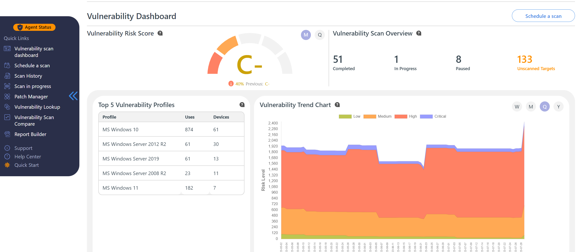
Vulnerability Scanning
With the Vulnerability Management capability, you can run internal, external, and Web App scans in your environment; find vulnerabilities, understand their root cause, prioritize remediation and deploy patches. Track progress and create easy-to-track mitigation plans.
Current and previous risk grades to assess vulnerability management and risk reduction progress over time
Identify focus areas based on most vulnerable systems
View vulnerability risk trends based on the number and severity of vulnerabilities found over selected time periods.
Notes:
Add note to this slide

Slide 20
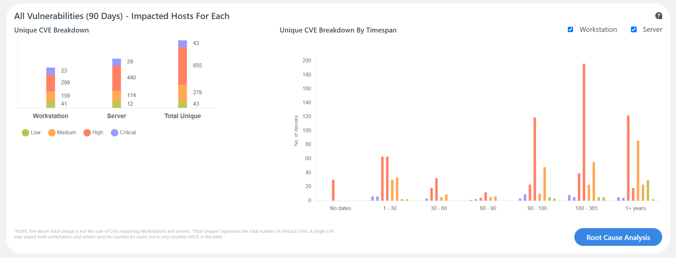
Targets with the Most Vulnerabilities
Easily discover machines that have the most vulnerabilities within the current selected reporting period (quarterly or monthly) and take steps to secure them quickly.
All Vulnerabilities with Impacted Hosts
View the number of Unique CVEs for Workstations (Desktops and Laptops) and Servers, broken down by severity.
Notes:
Add note to this slide

Slide 21
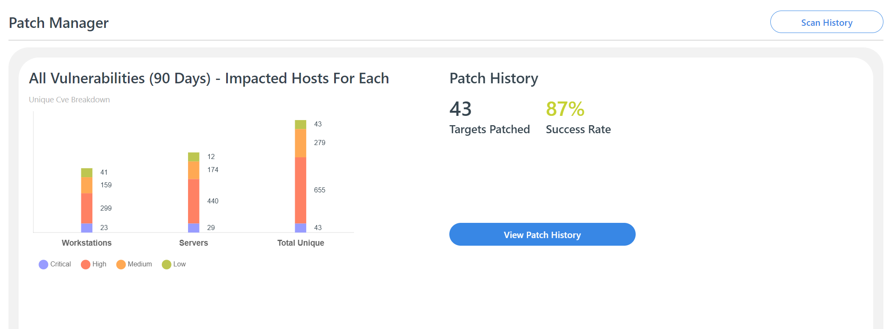
Patch Management
Patch vulnerabilities in a wide range of Windows-based third-party apps and view patch status on Targets (machines) across your environment.
Notes:
Add note to this slide

Slide 22
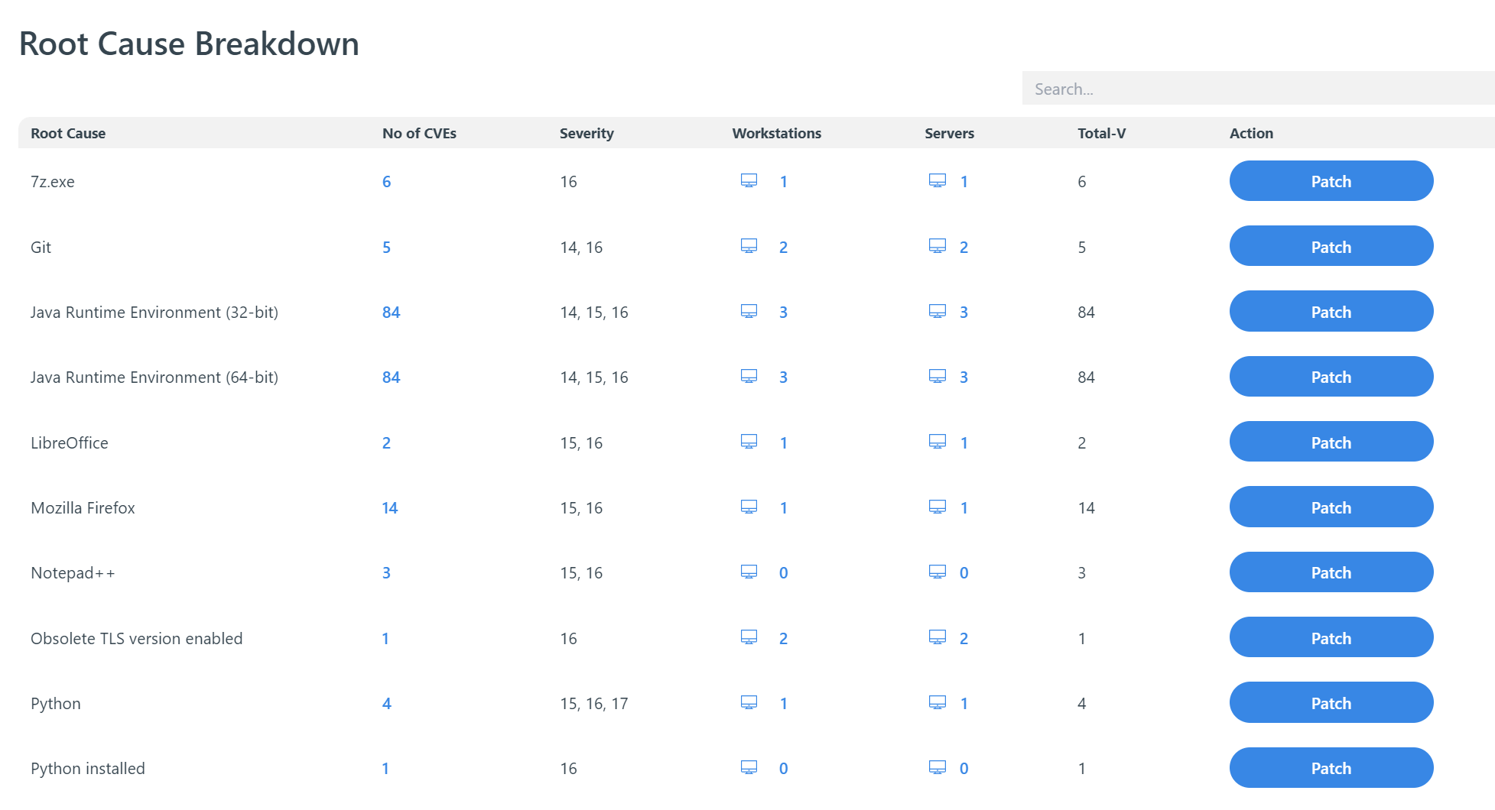
Root Cause Analysis
Drill-down into the root causes of CVEs in the environment, and the systems affected by each. Schedule patches and software updates to address different root causes. CYRISMA enables you to patch vulnerabilities in a wide range of Windows-based third-party apps.
Notes:
Add note to this slide

Slide 23
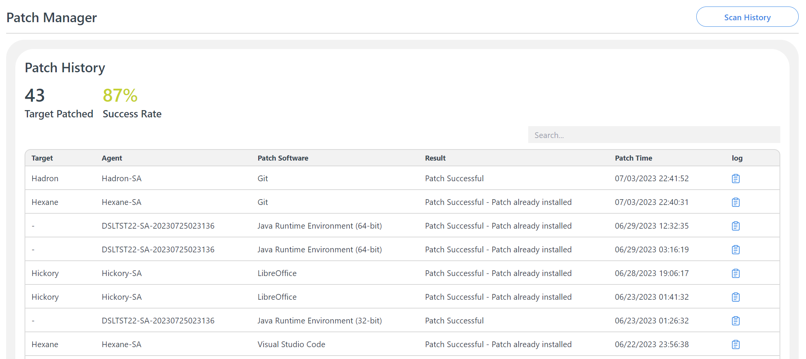
Patch History
View a complete list of patches applied so far, with details about the date and time when each patch was deployed on specific Targets, the Agent involved, patch software, whether the patch was successful, and log information for troubleshooting.
Notes:
Add note to this slide

Slide 24
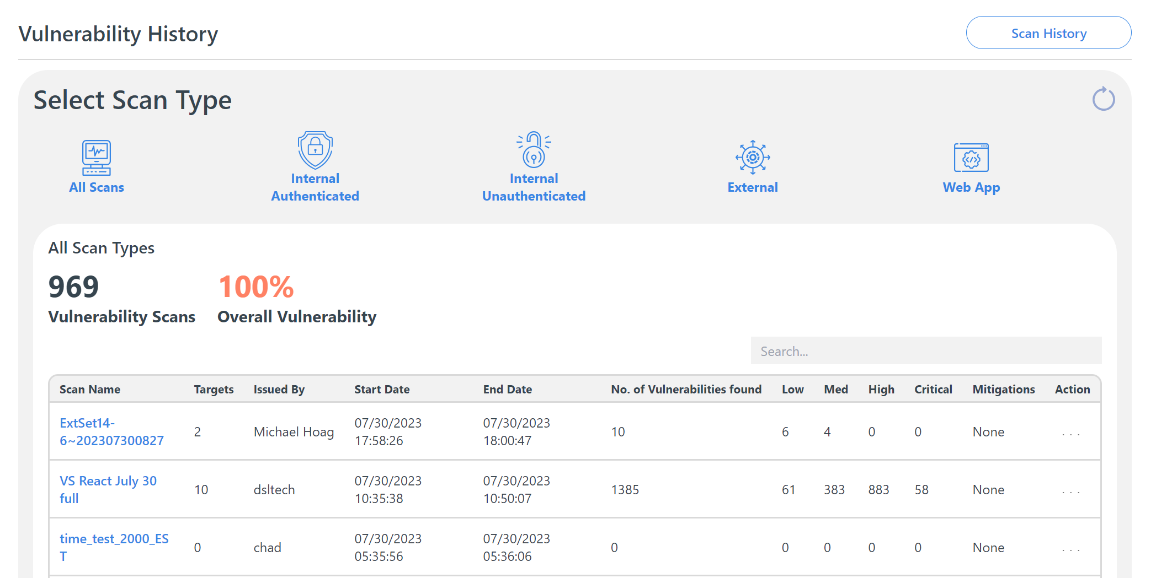
Vulnerability History
View vulnerability scan history by scan type. The information shown includes scan names, all the targets scanned, individuals who issued the scans, start and end dates, no. of vulnerabilities found broken down by severity, mitigation options and Actions to take.
Notes:
Add note to this slide

Slide 25
Vulnerability Scan Reports
Easily generate vulnerability scan reports. Choose between Full Detail Reports, Specific Detail Reports, or an Executive Summary.
Maintain a low level of vulnerability risk by scanning devices regularly & taking immediate action when new vulnerabilities are found.
Notes:
Add note to this slide

Slide 26
4
SECURE BASELINE SCANS
Compare and assess your Operating Systems’ (Linux, Windows, Mac) existing configuration settings against established security frameworks like the CIS Benchmarks and DISA STIGs.
Find security gaps and misconfigurations, and strengthen configuration based on scan results. Check for deviation from a secure state by scheduling regular scans.
Notes:
Add note to this slide

Slide 27
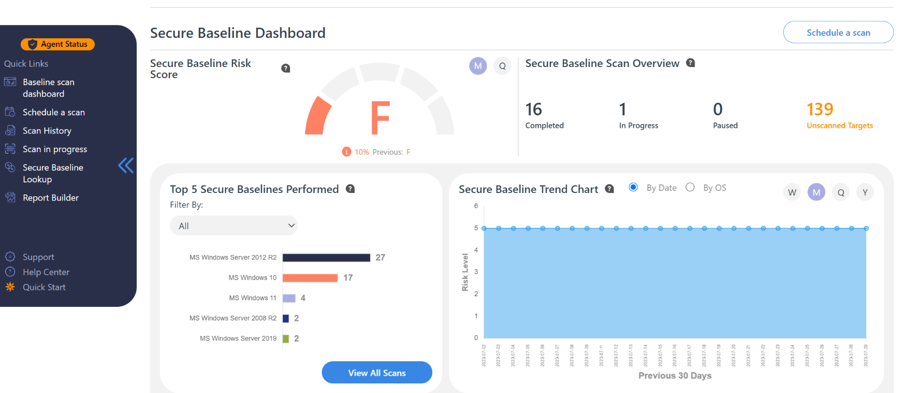
Secure Baseline Dashboard
The Secure Baseline Scan dashboard provides an overview of how your previous or current baseline scans have performed or are performing. Through this, you can determine how vulnerable your instance is based on Operating System (OS) configuration settings and group policy practice. The risk grades give you an easy way to compare previous and current risk levels based on scan results. Use the Secure Baseline Trend chart to see performance in secure configuration and policy management over time.
Notes:
Add note to this slide

Slide 28
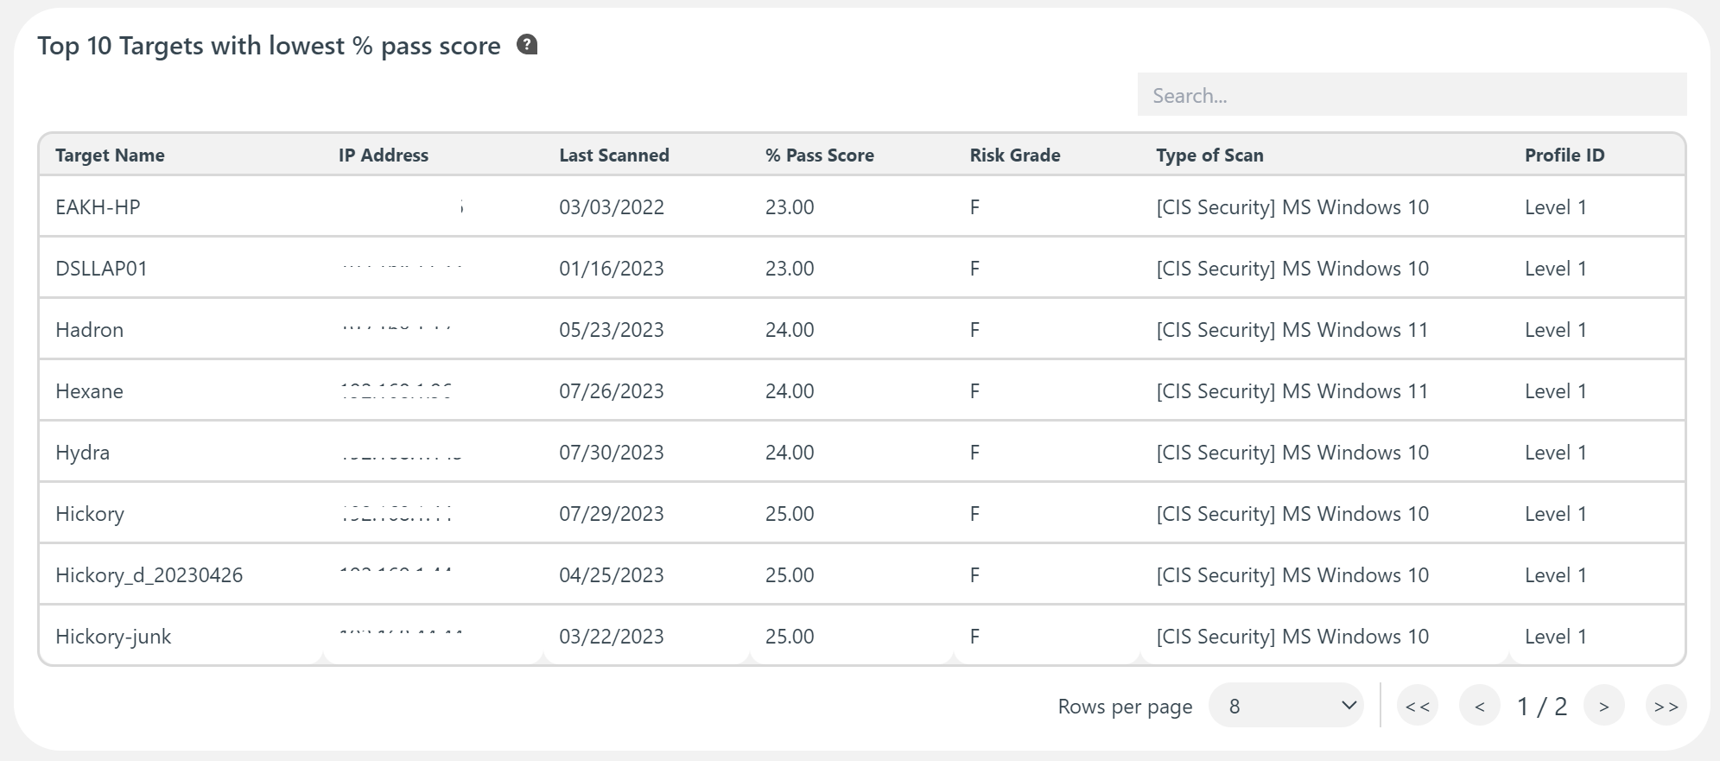
Discover Machines with the Lowest Scores to Prioritize remediation
Get a quick view of the top 10 machines that have the lowest pass scores to plan remediation and prioritize action items
Notes:
Add note to this slide

Slide 29
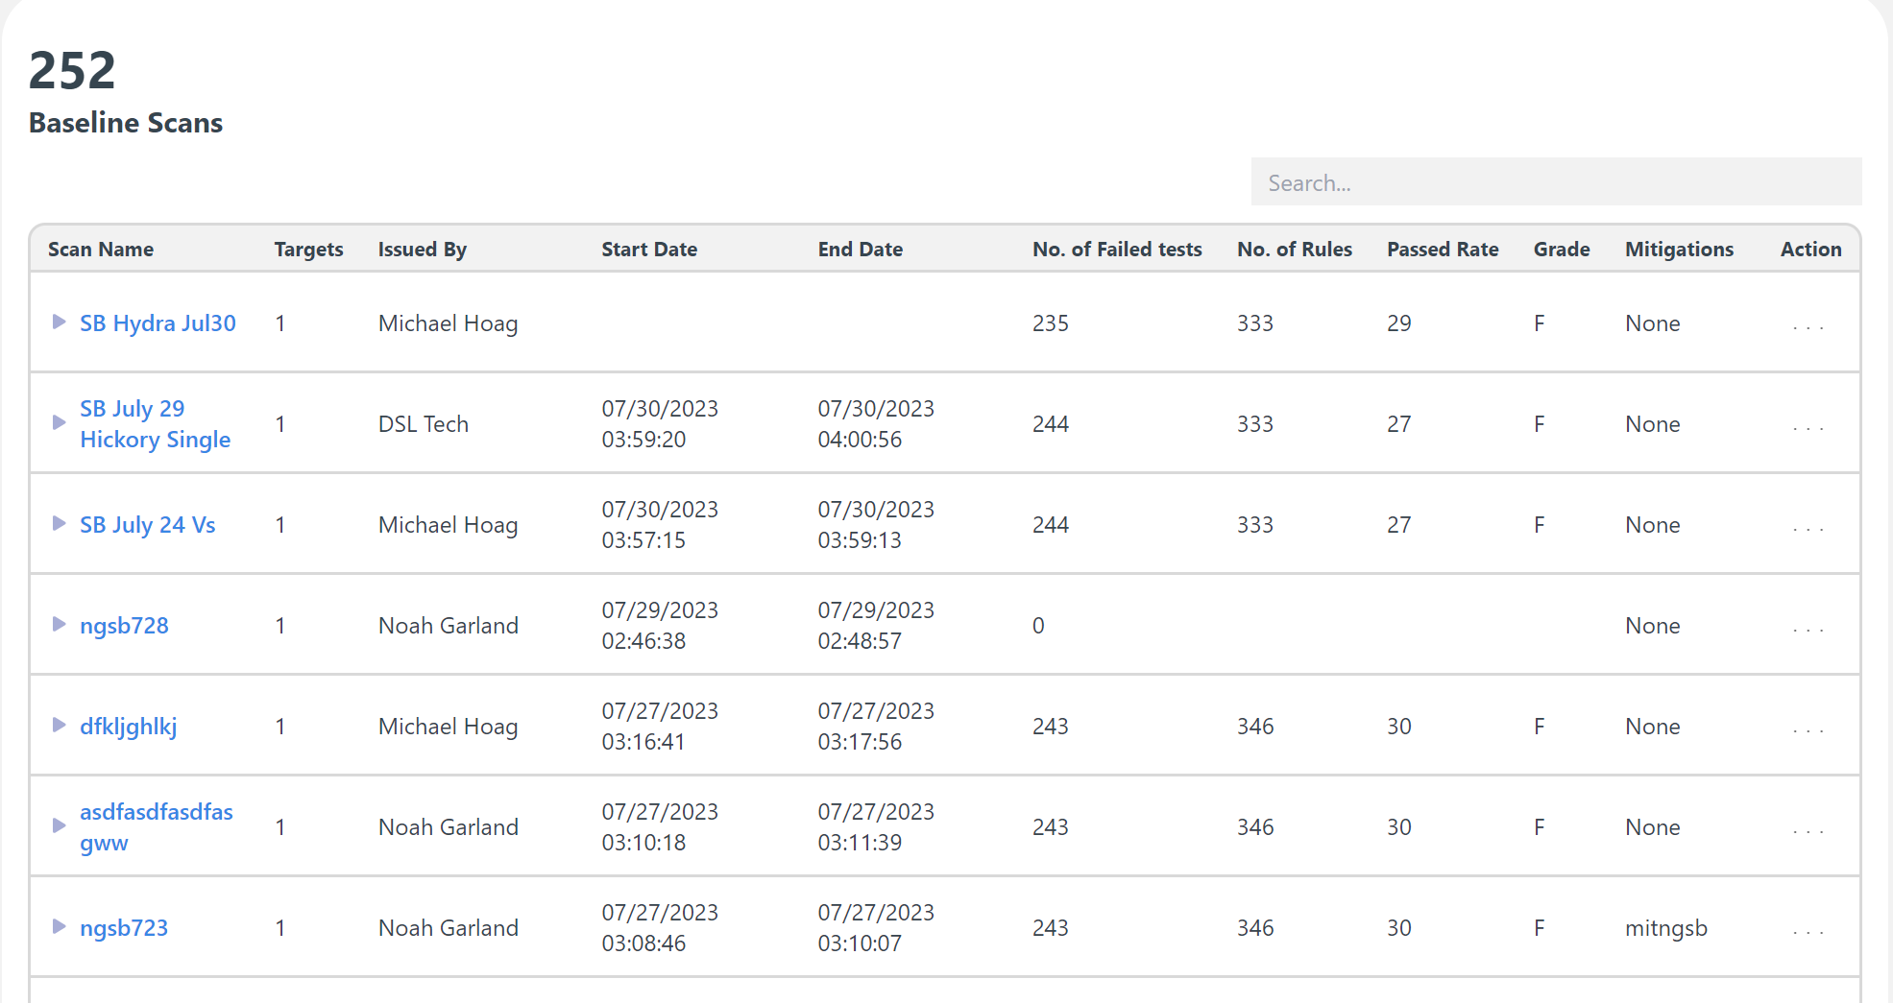
SECURE BASELINE HISTORY
Any existing Secure Baseline scans that have either been completed or canceled are shown within the secure baseline scan history. You can see the number of completed baseline scans, overall failure rate, and a list of a scans with an overview of each scan result. Create mitigation plans starting with the lowest pass scores to comply with established security standards.
Notes:
Add note to this slide

Slide 30
5
COMPLIANCE
Move closer to meeting regulatory compliance requirements. Assess compliance against multiple frameworks and implement tactical controls from within the platform. Monitor Active Directory (on-prem and Azure) and Microsoft Secure Score, and compare performance against other organizations in the same industry.
Notes:
Add note to this slide

Slide 31
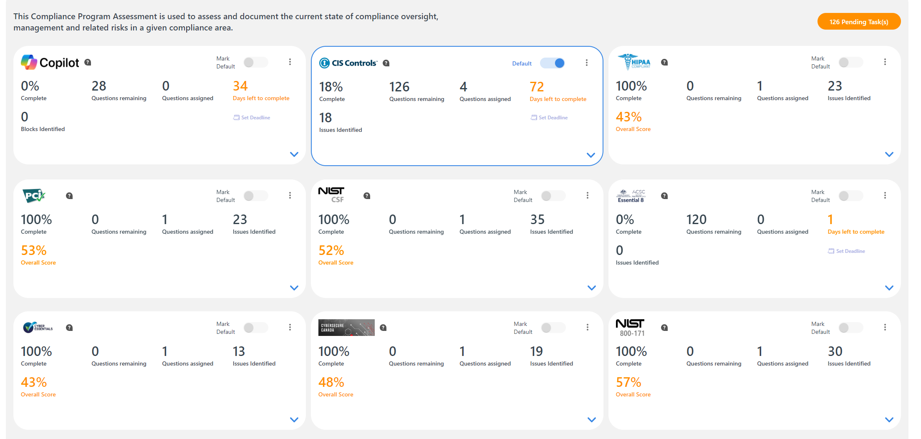
Compliance Assessments
Track and assess your organization’s compliance with regulatory and best practice frameworks like ISO 27001, PCI DSS, HIPAA, NIST Cybersecurity Framework, NIST 800-171, the CIS Controls, Australia’s Essential Eight, the UK’s Cyber Essentials and CyberSecure Canada
Notes:
Add note to this slide

Slide 32
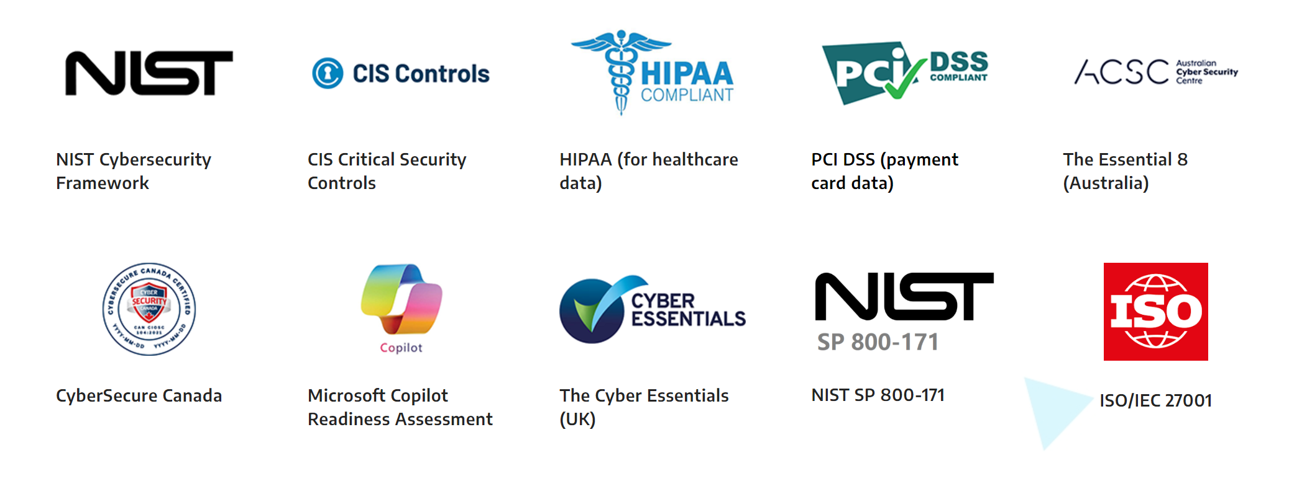
Compliance Frameworks Covered
Notes:
Add note to this slide

Slide 33
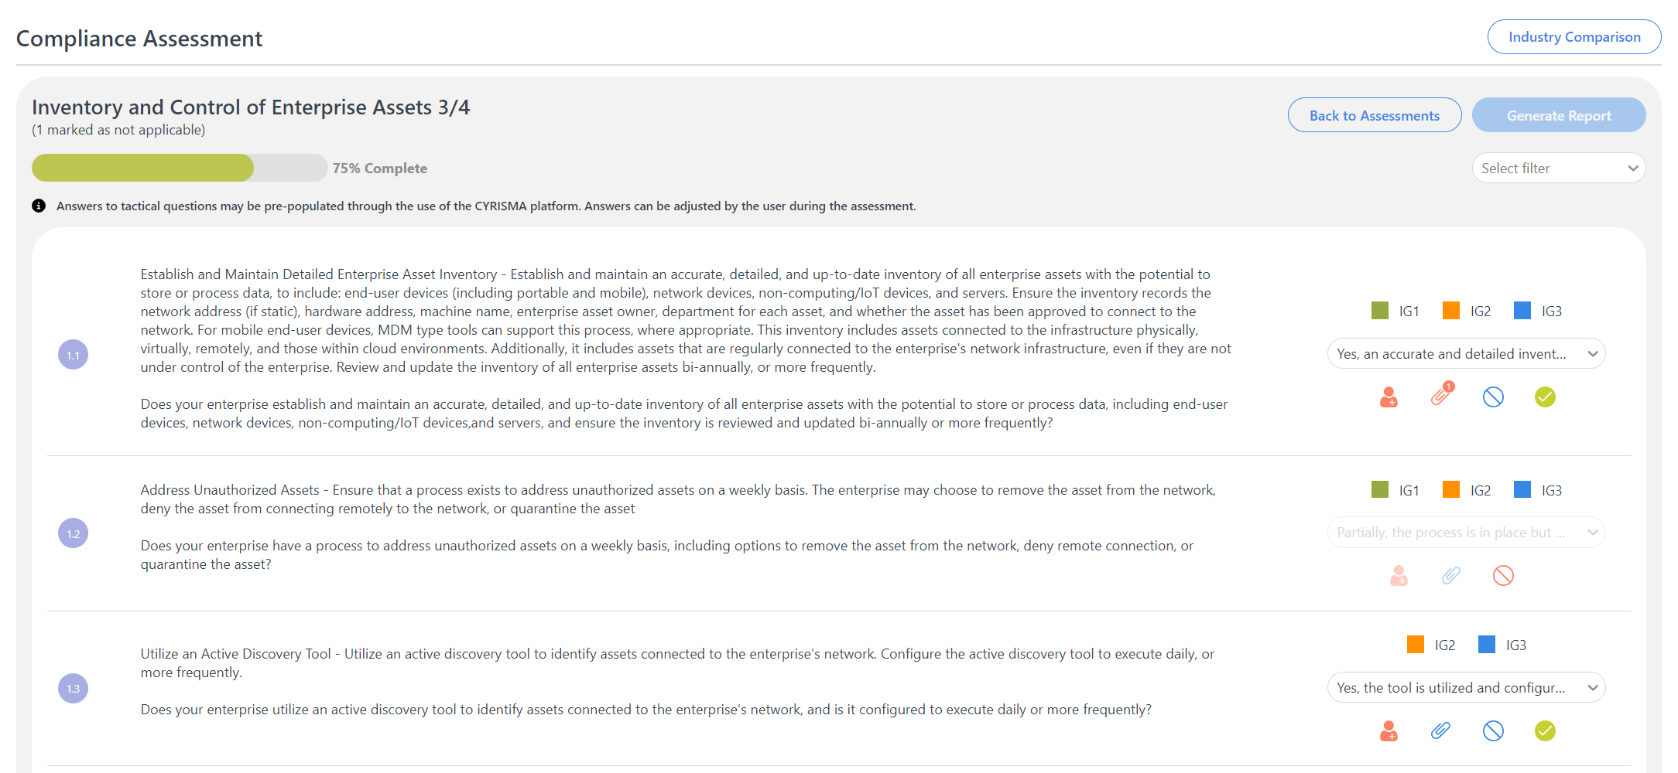
Compliance Tracking Questionnaires
Track Compliance against the standards covered using detailed questionnaires, upload evidence documents, assign questions to other team members, and generate detailed compliance reports.
Notes:
Add note to this slide

Slide 34
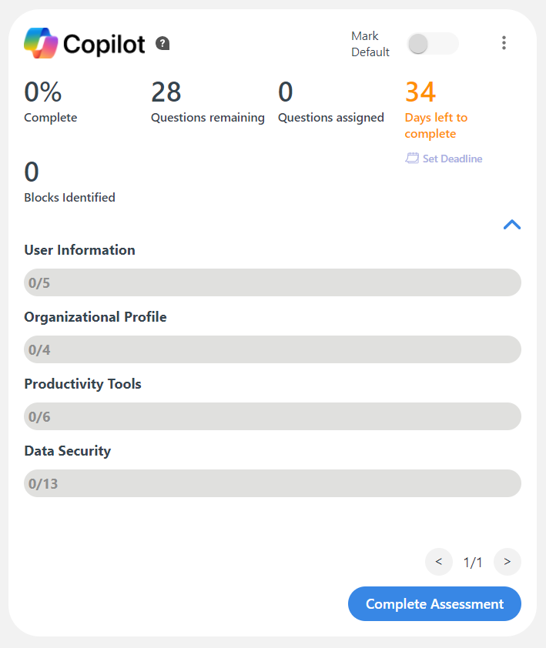
AI Readiness – Microsoft Copilot Readiness Assessment
Ensure that your sensitive data remains secure as you leverage the transformational capabilities of Microsoft Copilot.
Our Microsoft Copilot Readiness Assessment builds on the Microsoft 365 Data Scanning capability, and enables you to examine your organization’s Copilot readiness under four categories:
User Information
Organizational Profile
Productivity Tools
Data Security
Notes:
Add note to this slide

Slide 35
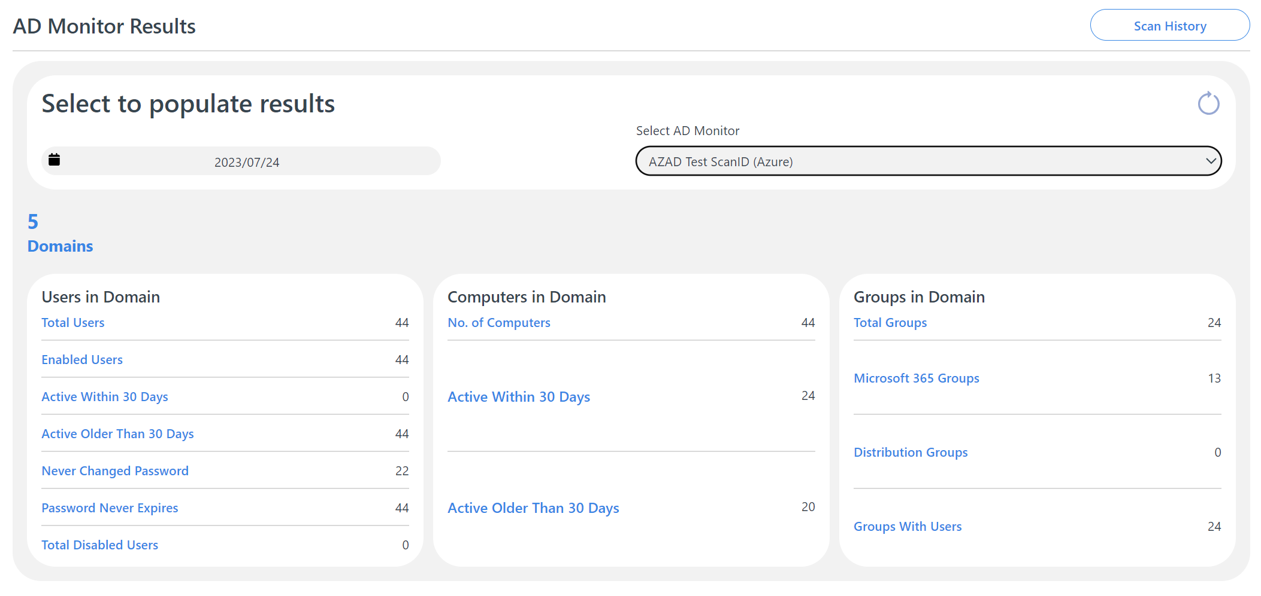
Active Directory (AD) Monitoring - On-prem & Azure
Easily monitor Active Directory (both on-prem and AD Azure) by adding an agent. View active accounts vs disabled accounts, information about users, devices and groups in domain, and users’ activity and password security status. Monitor any changes and do a basic clean-up.
With this information at hand, you can keep your Azure AD environment aligned with any governance, risk management, and compliance (GRC) requirements.
Notes:
Add note to this slide

Slide 36
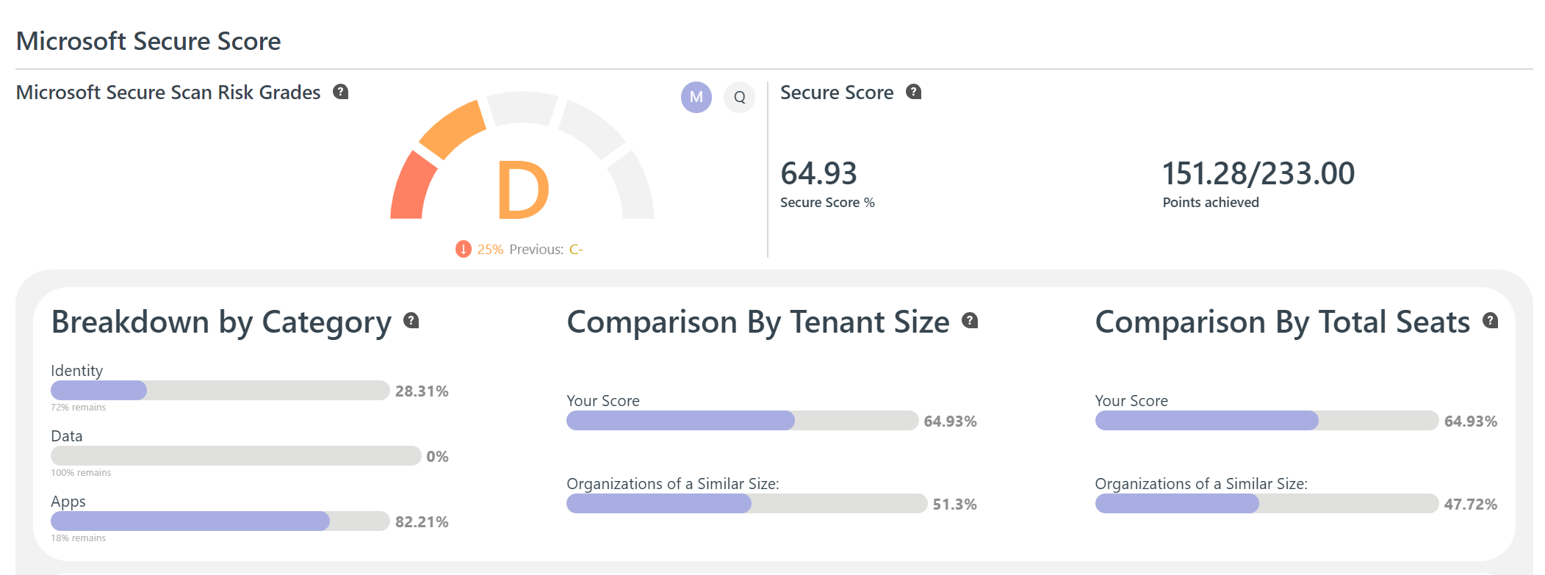
Microsoft Secure Score Dashboard
Get help with implementing security settings within Microsoft Cloud to reduce the risk of data leakage and compromised accounts. Implement cyber security best practices to meet compliance requirements.
The Microsoft Secure Score Dashboard provides you with trends and metrics, along with the items that you must complete in order to increase the security posture of your Microsoft Cloud environment (Azure, Microsoft 365, etc).
Notes:
Add note to this slide

Slide 37
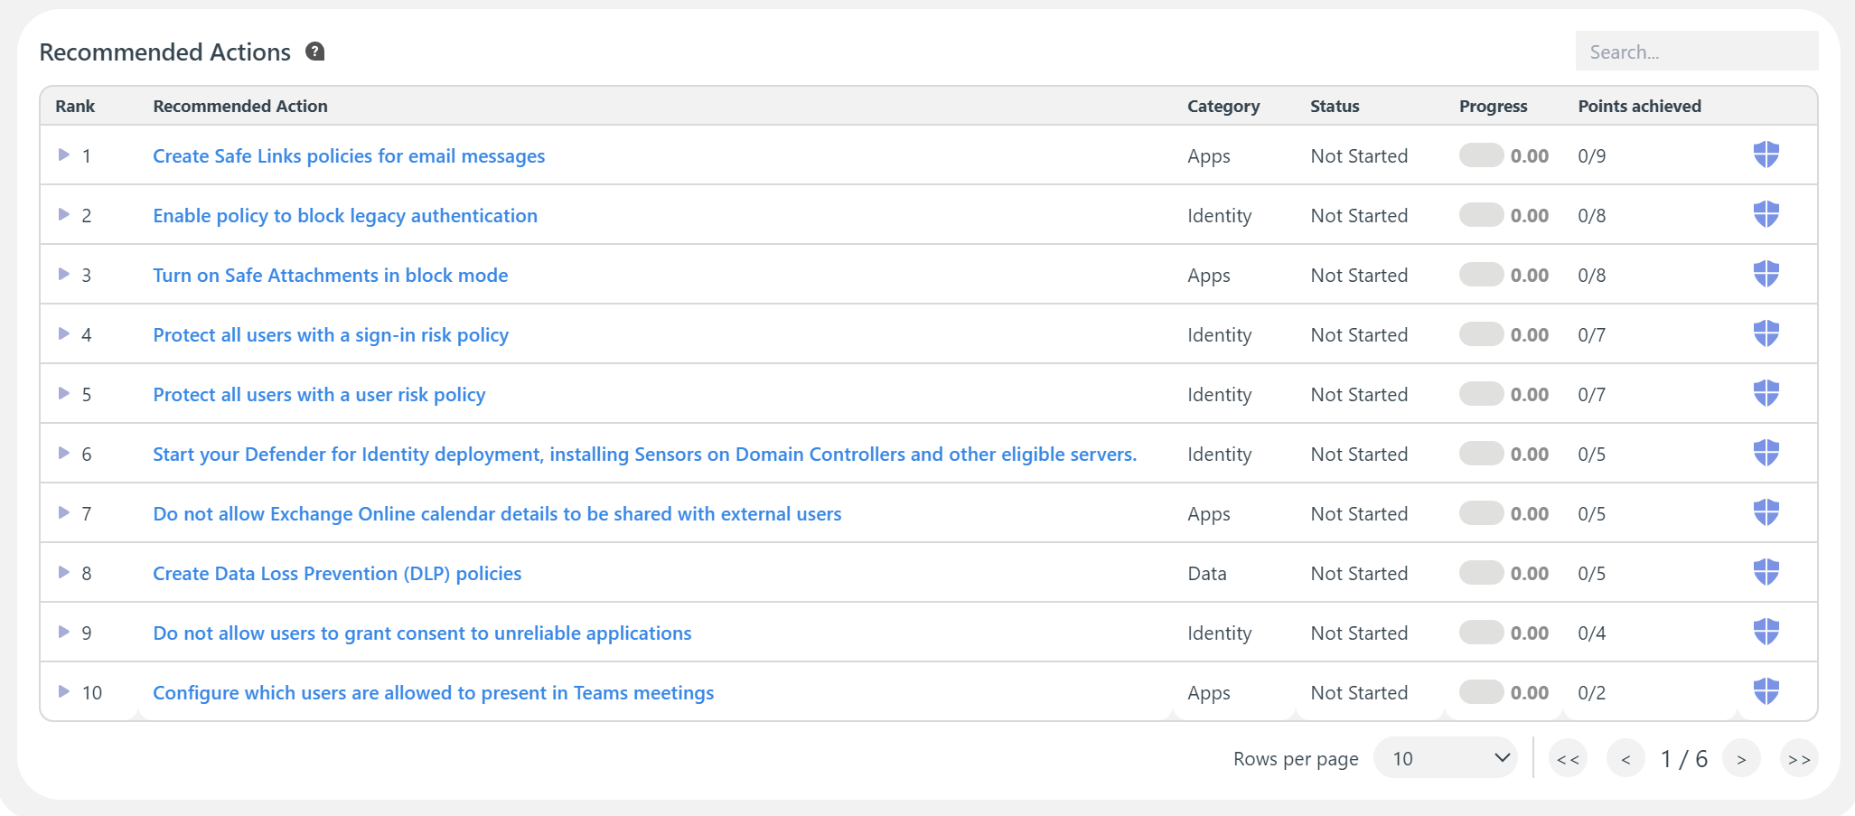
Microsoft Secure Score - Recommended Actions
View recommended actions ranked by priority of what you should implement first within your Microsoft Cloud environment.
Notes:
Add note to this slide

Slide 38
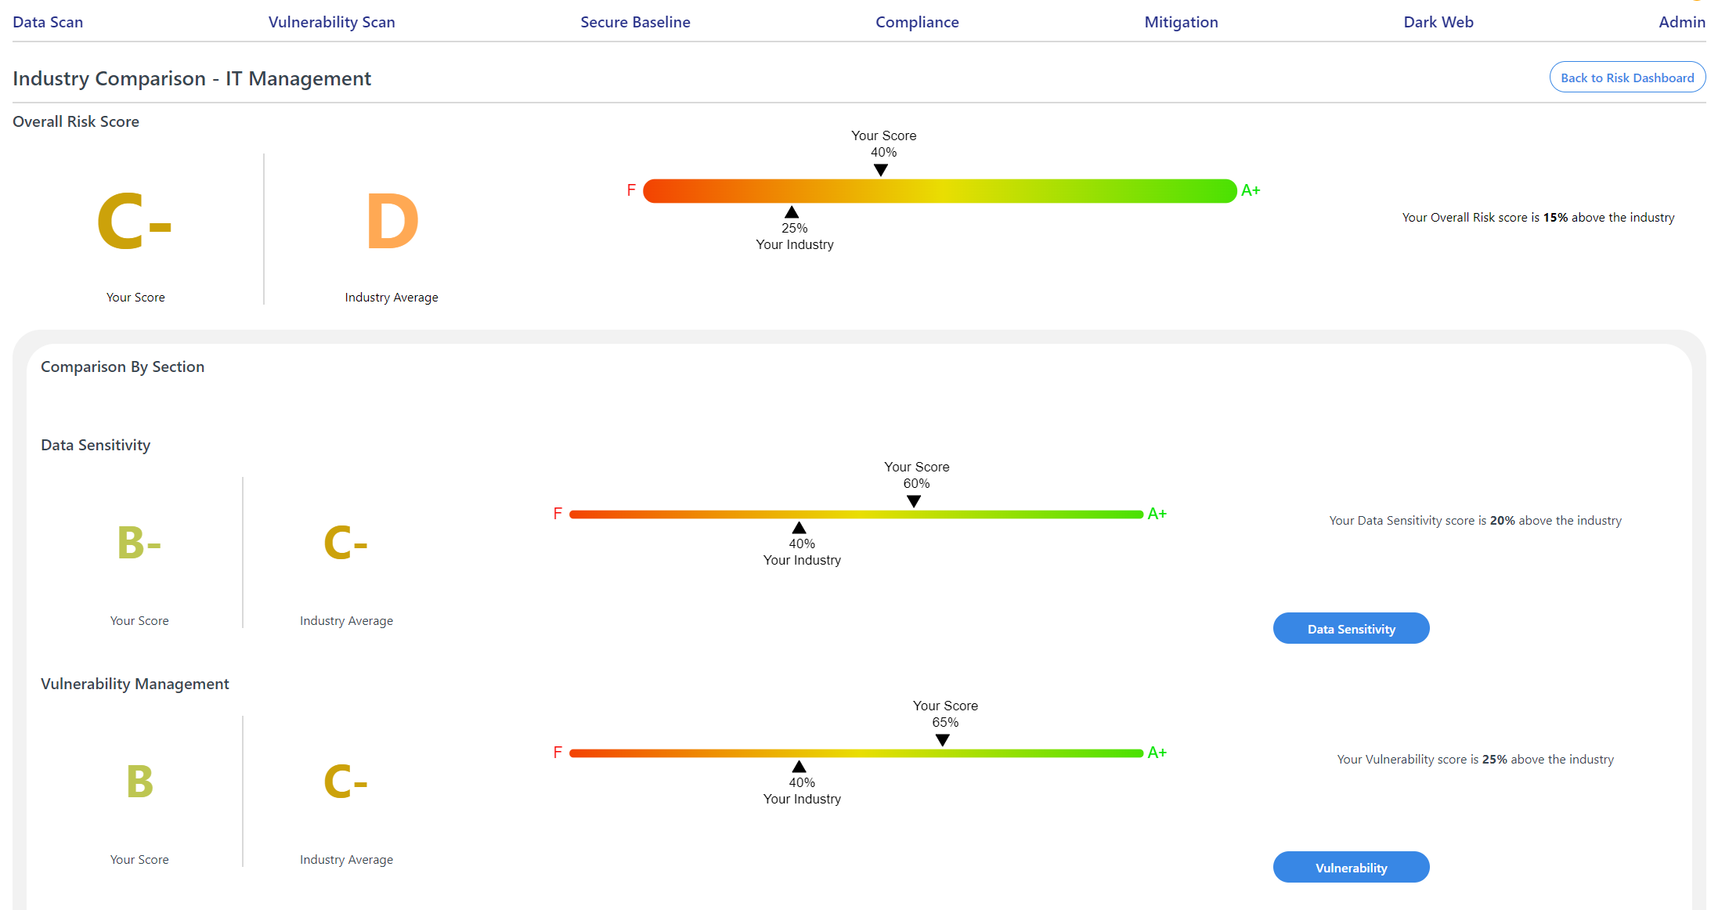
Industry Comparison
Use the Industry Comparison Dashboard for insights into your organization’s risk scores relative to others in the same industry. Set the industry type for your instance, and see your scores benchmarked against comparable organizations. This dashboard enables you to understand your position on various risk metrics and to take action where needed.
Notes:
Add note to this slide

Slide 39
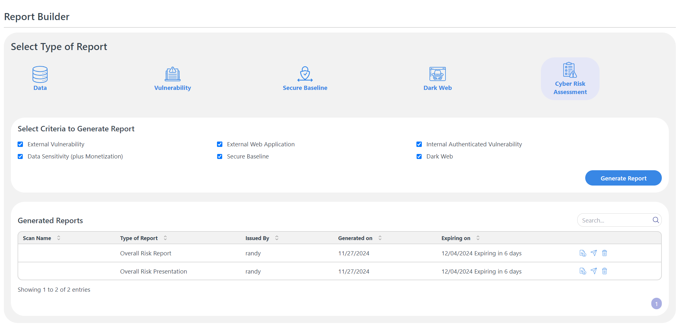
Report Builder
Generate reports for individual scan categories, or an overall Cyber Risk Assessment Report after completing a set of scans.
Notes:
Add note to this slide

Slide 40
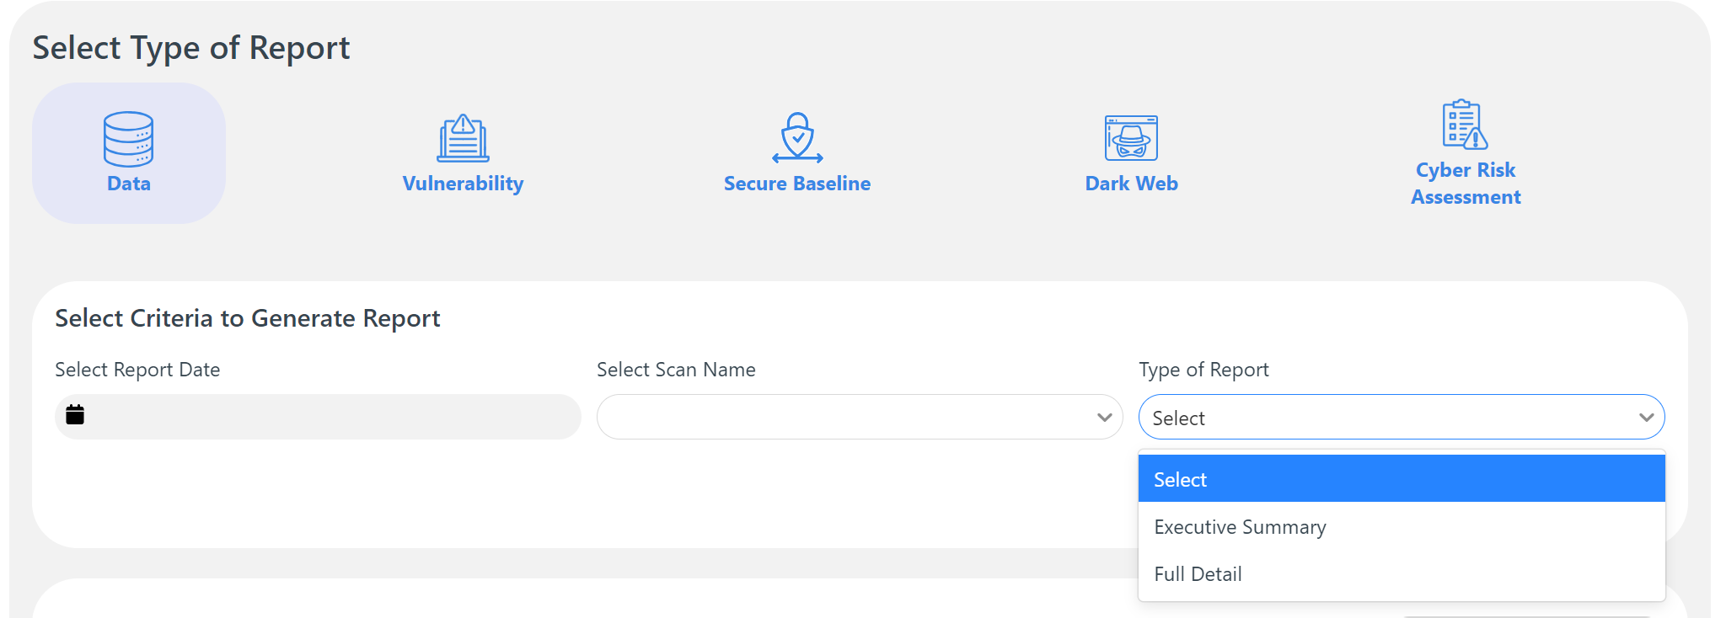
Generate Cyber Risk Assessment Reports
Generate a detailed report that shows you a breakdown of your cyber risk based on the latest assessment of your environment. Each risk category /scan result is accompanied by a grade or score, with A+ representing low risk of compromise or breach and F representing extremely high risk.
You can also generate an Overall Risk Assessment Presentation which is a more concise document designed especially for easier communication with the board, senior management and other stakeholders.
Notes:
Add note to this slide

Slide 41
6
DARK WEB MONITORING
Monitor the dark web for leaked or stolen company data and underground discussions mentioning your organization, its domains, emails, or IP addresses. View data and posts that go back to up to a year.
Track information in breach records and dark web marketplaces (where your organization’s data may be dumped or be up for sale) and underground forums and ransomware discussions (where hackers may be discussing your data in the context of an attack or a breach.)
Notes:
Add note to this slide

Slide 42
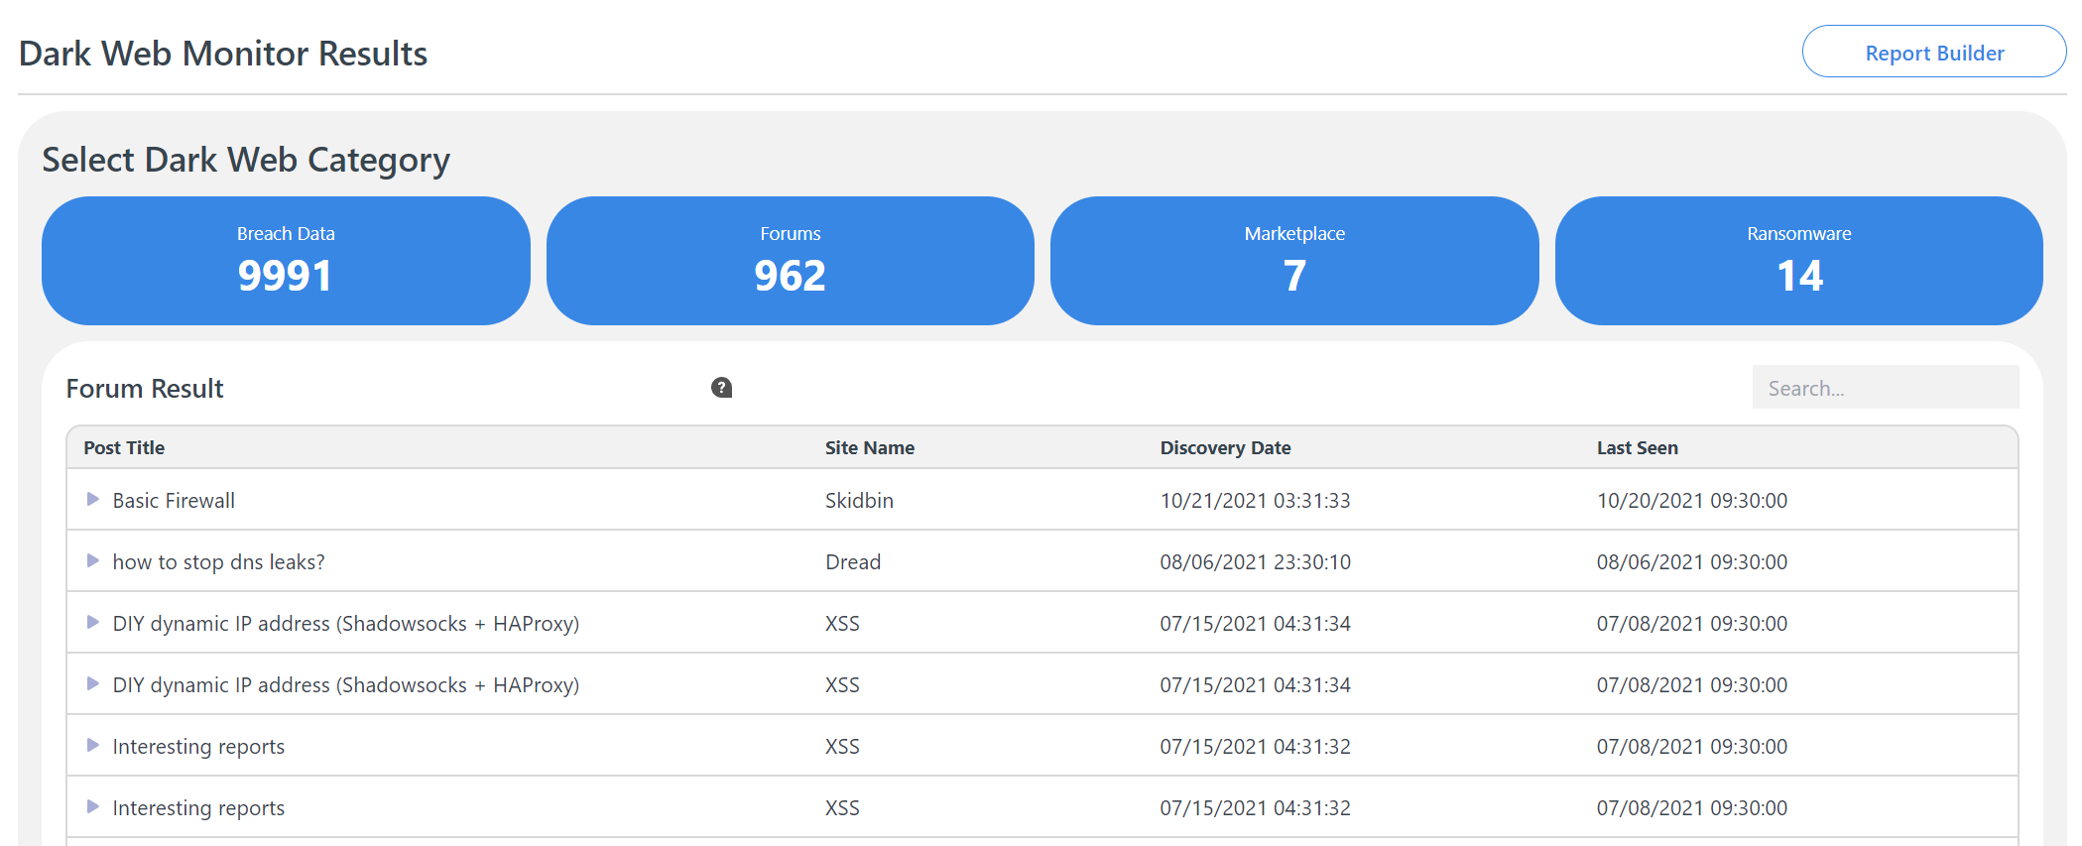
Track your organization's information on the dark web
Continually monitor the dark web for data associated with your brand so you can predict and stop attacks that may potentially target your internal systems. Make strategy changes and pivot quickly to stop attacks and control damage.
Notes:
Add note to this slide

Slide 43
Breach Data and Ransomware Discussions
View breach data including victim accounts, sources where the compromised records were discovered, and discovery
dates. Also monitor any mention of your organization or IPs in dark web marketplaces, forums and ransomware discussions. Receive notifications when data associated with the company is found on the dark web.
Translation Feature
For dark web discussions in foreign languages, the platform includes a translation feature.
Notes:
Add note to this slide

Slide 44
7
RISK MITIGATION
Create data-driven, actionable, and easy-to-track mitigation plans under each scan category (Vulnerability, Sensitive Data Discovery, Secure Baseline) to quickly reduce risk in your environment.
Assign tasks to team members, data owners, or end users; set start and end dates to track progress and stay on top of mitigation efforts.
Notes:
Add note to this slide

Slide 45
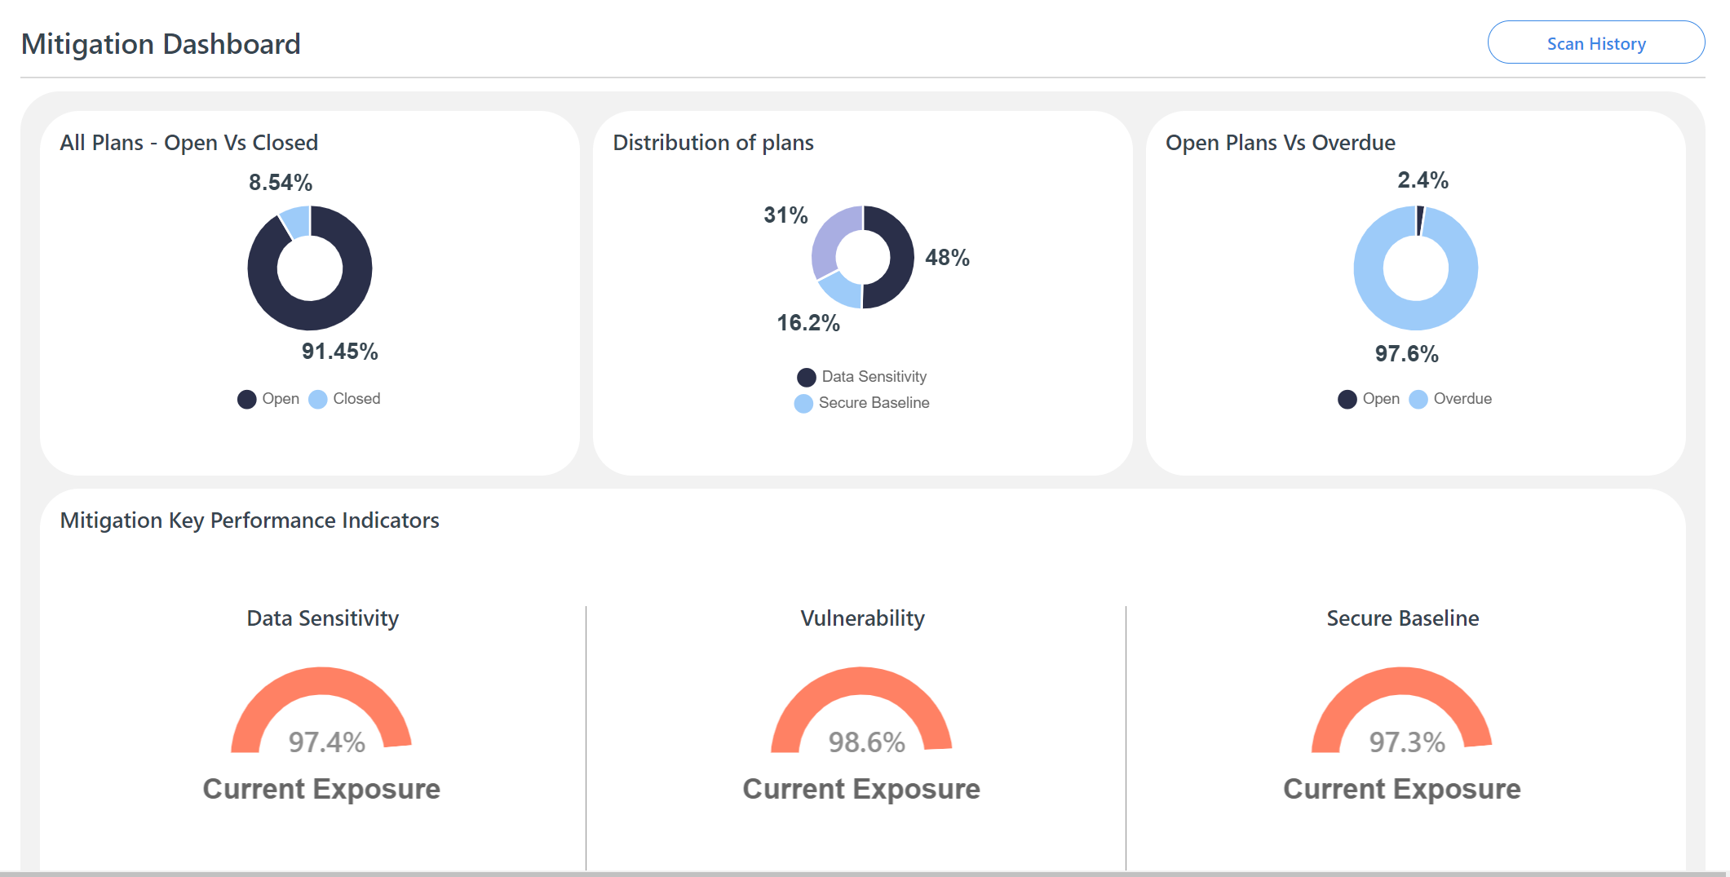
Mitigation Dashboard
The Mitigation Dashboard shows you the overall status of mitigation plans in different scan categories.
Get a quick view of:
All plans vs closed plans
Distribution of mitigation plans across scan categories (Data Sensitivity, Secure Baseline, Vulnerability)
Open plans vs plans that are overdue
Notes:
Add note to this slide

Slide 46
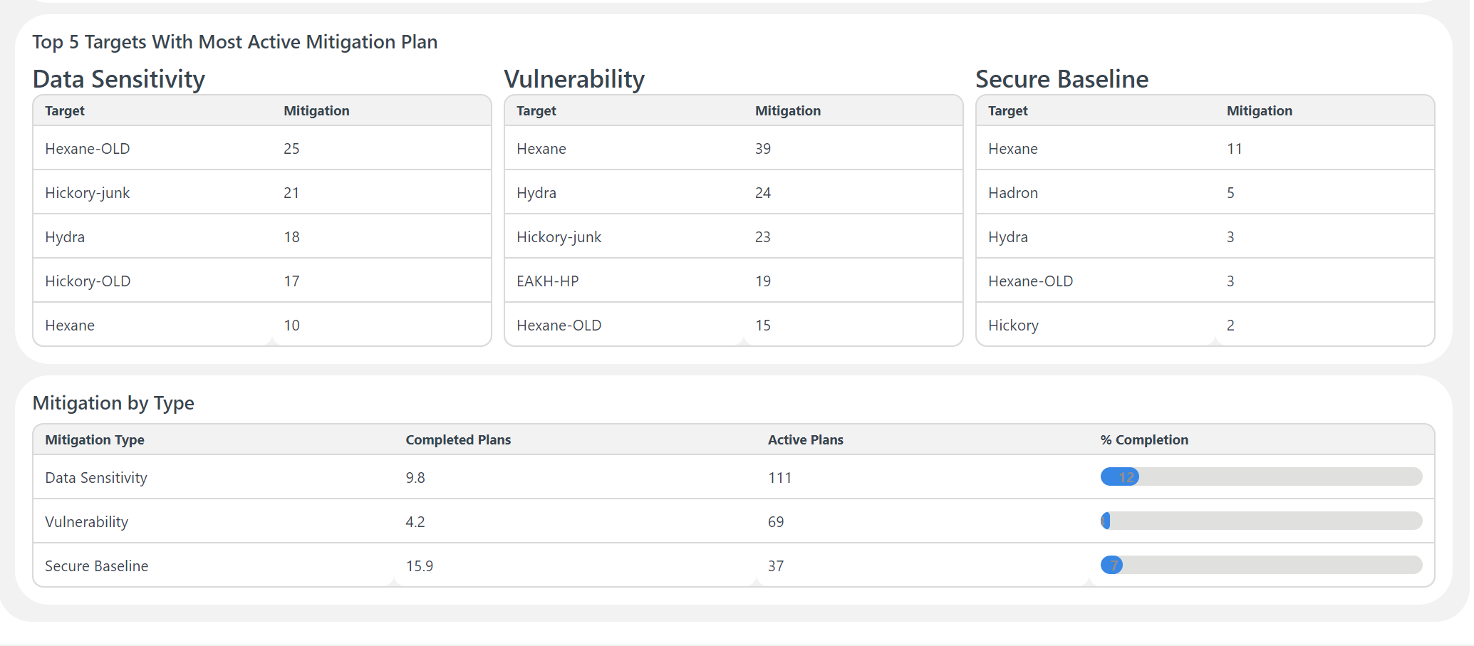
View Targets (Devices) with the Most Active Mitigation Plans
Notes:
Add note to this slide

Slide 47
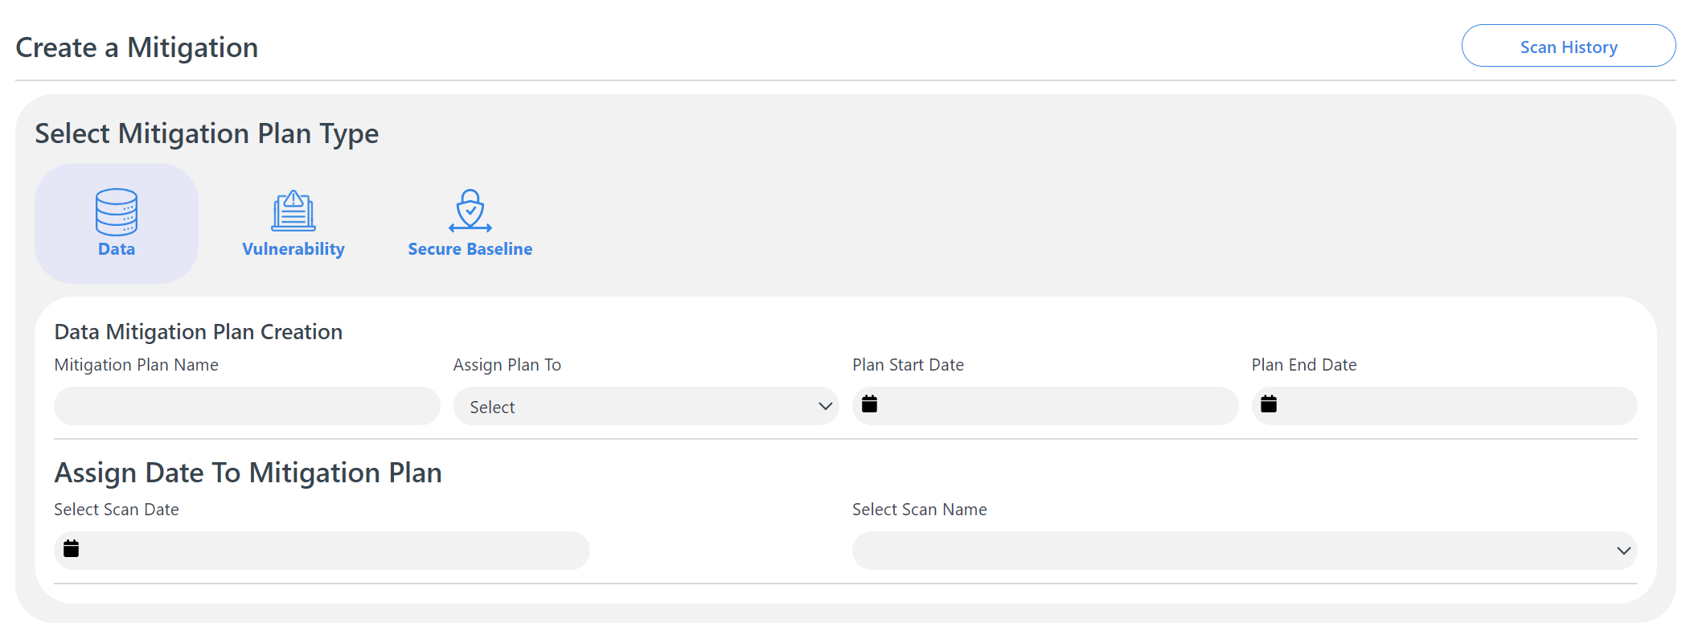
Easily Create Mitigation Plans Under any of the Scan Categories
Notes:
Add note to this slide

Slide 48
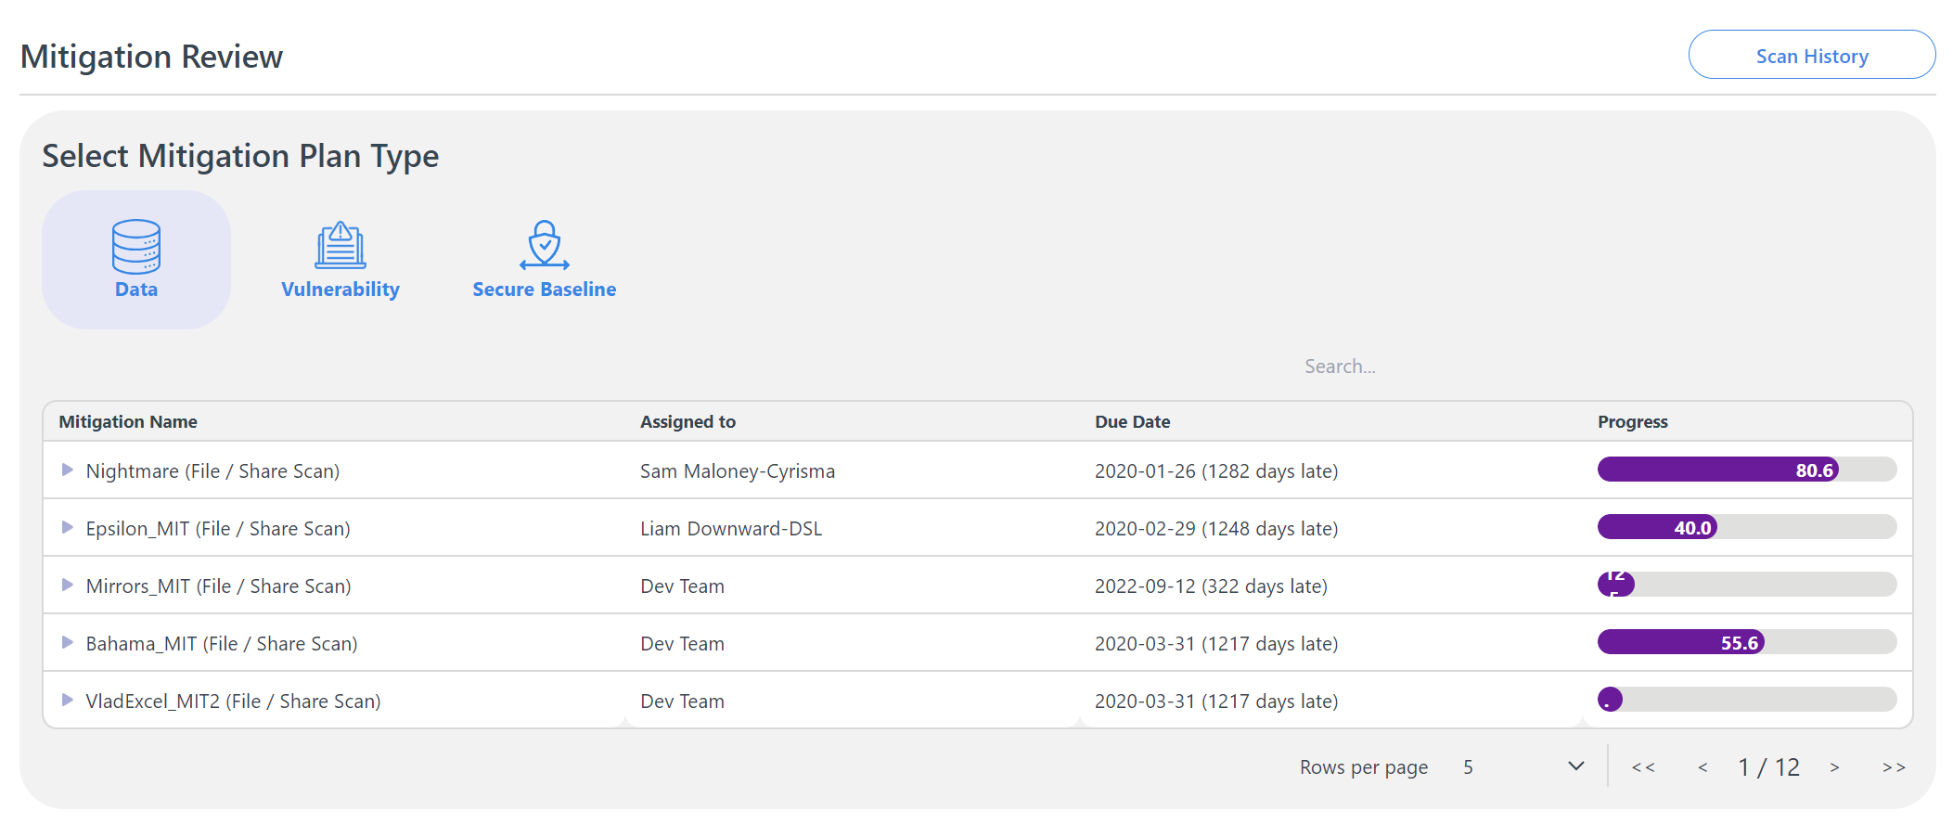
Review Progress on all Assigned Mitigation Plans
Notes:
Add note to this slide

